Slide 1


Some thoughts on digital innovations in Public Health:
For #PublicHealthPF event, Edinburgh
Graham Mackenzie
Consultant in Public Health Medicine
26 January 2018
Twitter @gmacscotland #PublicHealthPF
https://thefinchandpea.com/2013/08/27/john-snow-and-the-broad-street-pump/

Slide 2
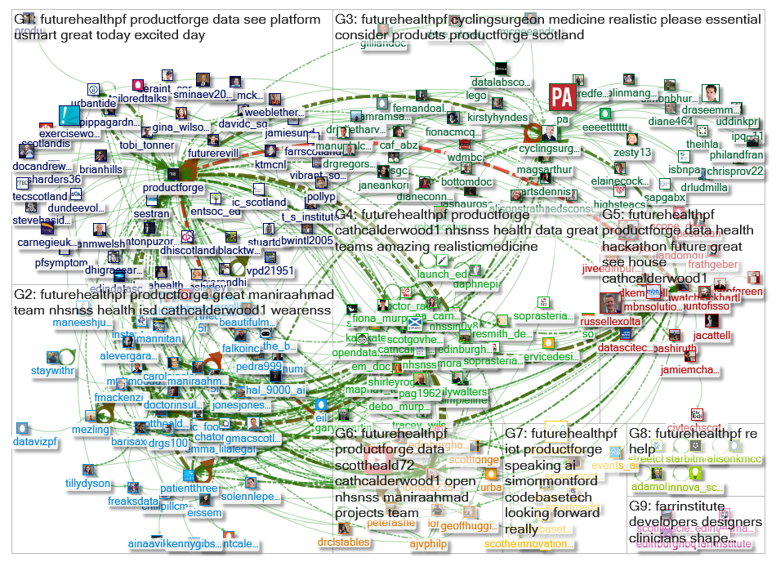
Why me? It’s not about this, honest…
Twitter @gmacscotland #PublicHealthPF

Slide 3

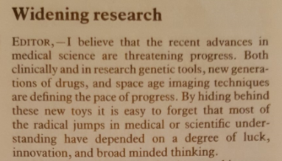
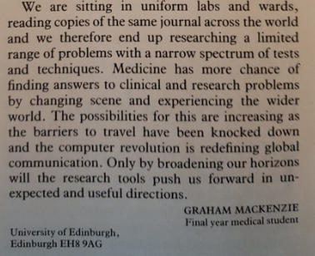
Student BMJ 1994
Twitter @gmacscotland #PublicHealthPF

Slide 4

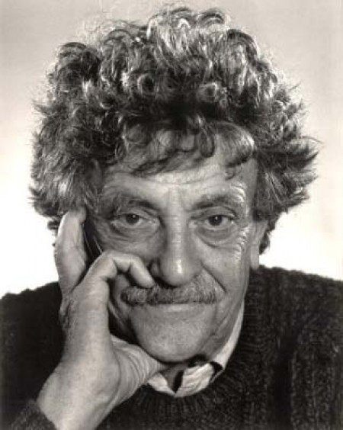
Working at the edge – opportunities
(Heard through @helenbevan)
Twitter @gmacscotland #PublicHealthPF

Slide 5
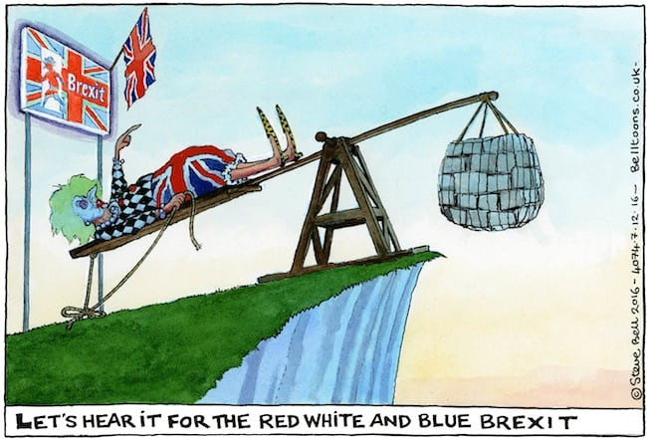
…and threats
Twitter @gmacscotland #PublicHealthPF

Slide 6

Key ingredients of innovation?
Curiousity | Creativity | Connections | Fun
Twitter @gmacscotland

Slide 7
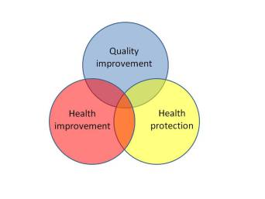


What is Public Health?
https://scotpublichealth.com/2017/04/17/what-is-public-health-some-reflections-for-teaching/

Slide 8

What is a Public Health approach? (1)
Twitter @gmacscotland #PublicHealthPF

Slide 9
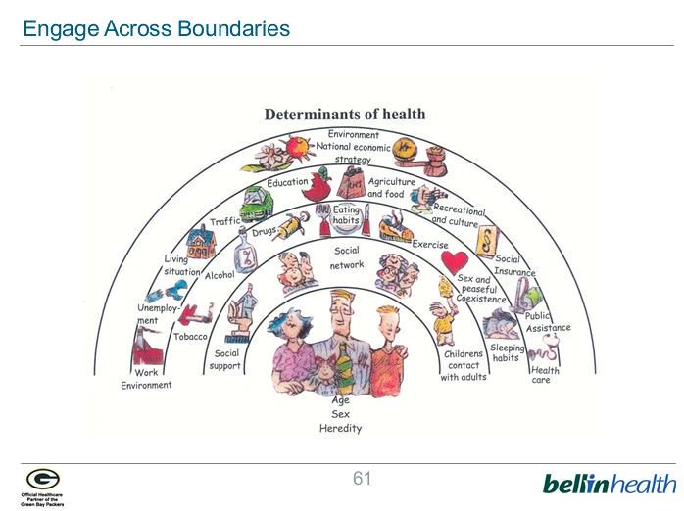
What is a Public Health approach? (2)
Twitter @gmacscotland #PublicHealthPF
After Dahlgren and Whitehead

Slide 10
4 thoughts on digital innovations in Public Health
https://scotpublichealth.com/2017/12/21/some-thoughts-on-digital-innovations-in-public-health/

Slide 11
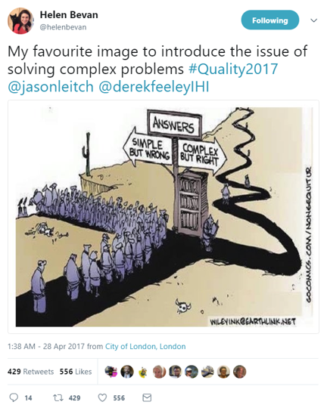

Slide 12
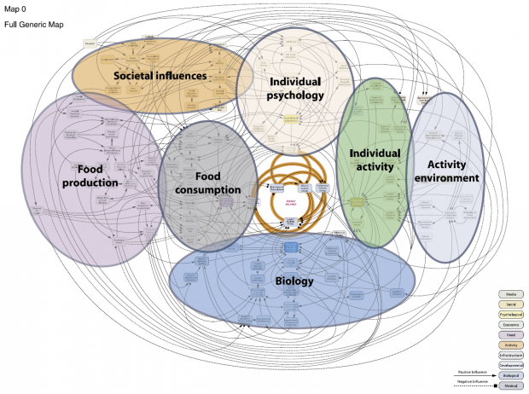
1) There are not simple answers to complex problems
Beware “lifestyle drift”
Twitter @gmacscotland #PublicHealthPF Foresight Report on Obesity

Slide 13
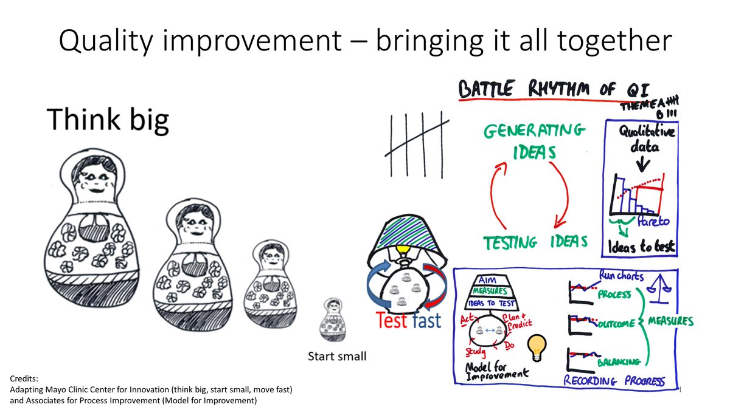
2) Think big, start small, test fast
Twitter @gmacscotland #PublicHealthPF

Slide 14
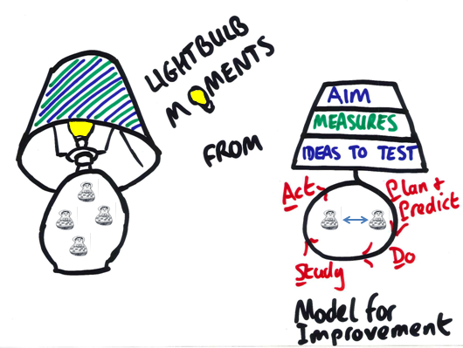
Quality Improvement – some tips
Be clear about the difference between:
  Tasks
  Tests
  Information gathering
Requires all three, but testing is the engine for QI (and innovation)

Slide 15

3) Averages are the enemy of progress

Slide 16
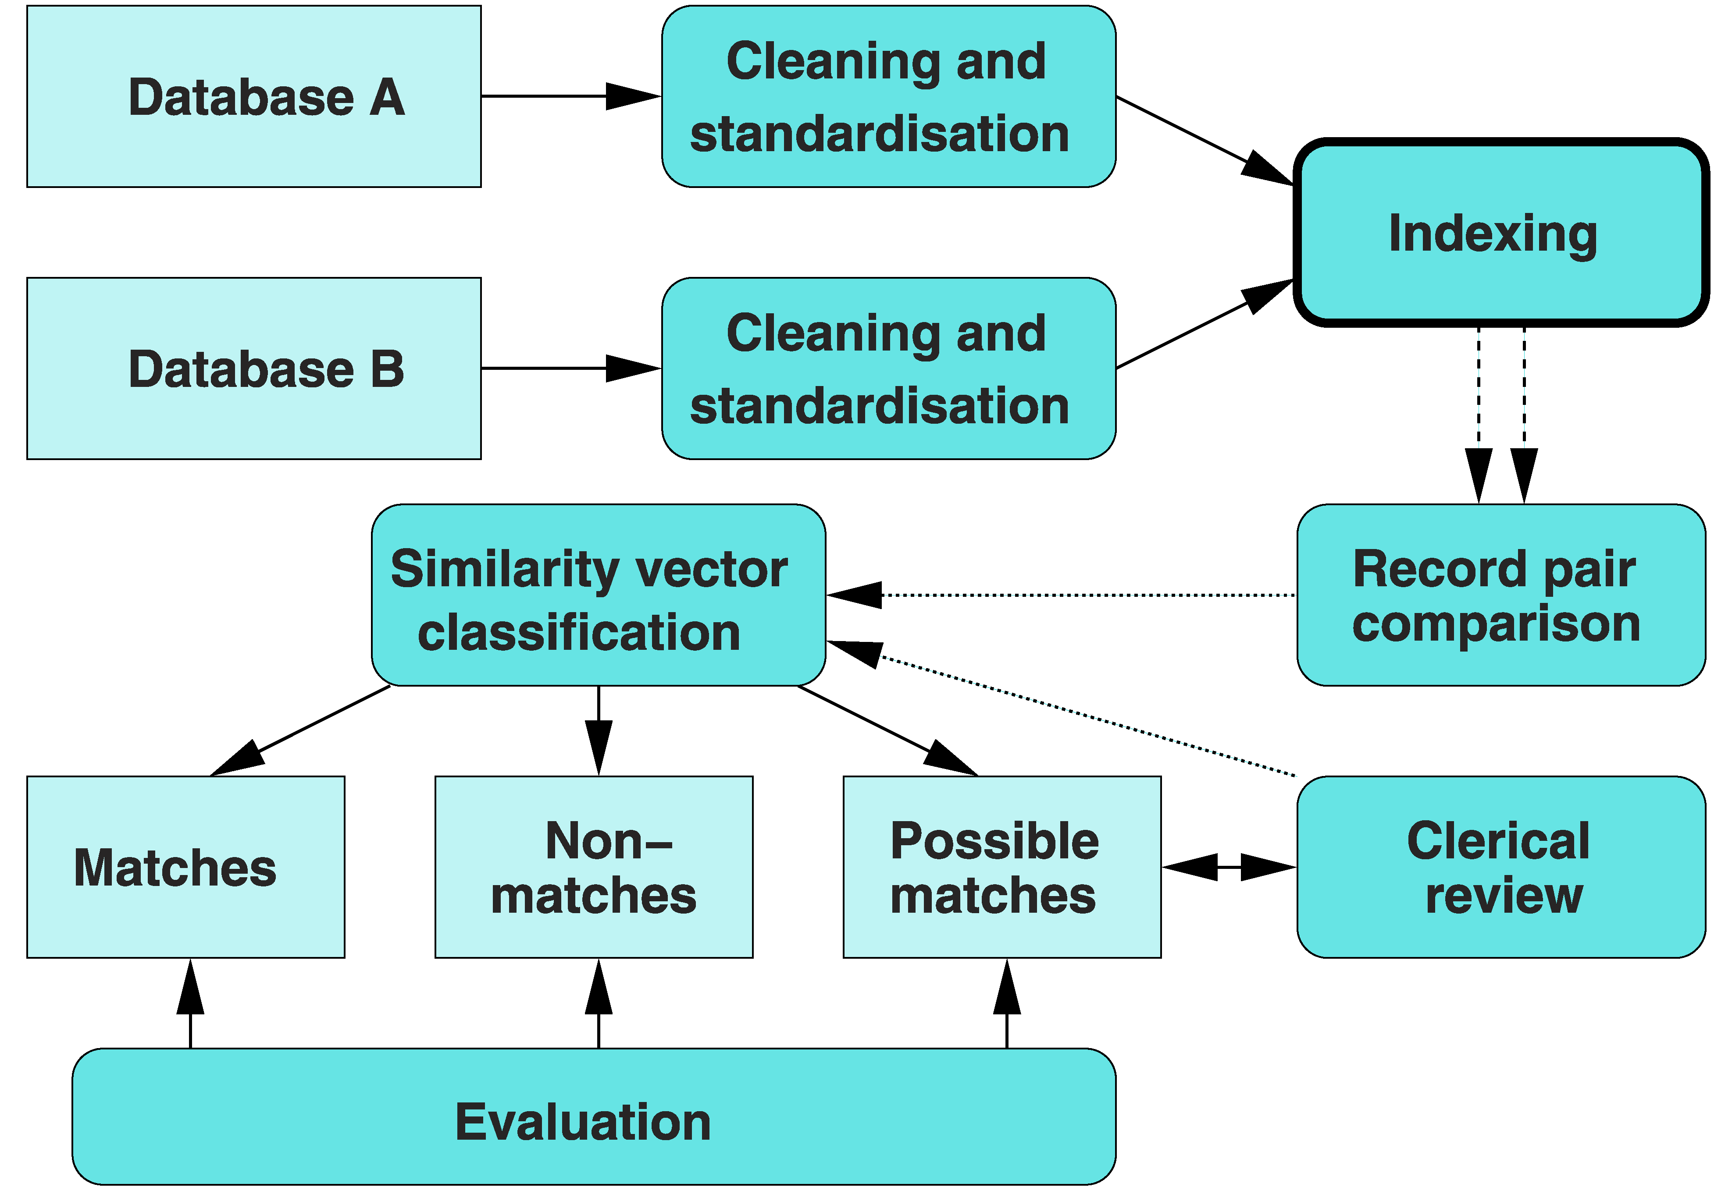
4) Routinely collected data are not usually enough

Slide 17
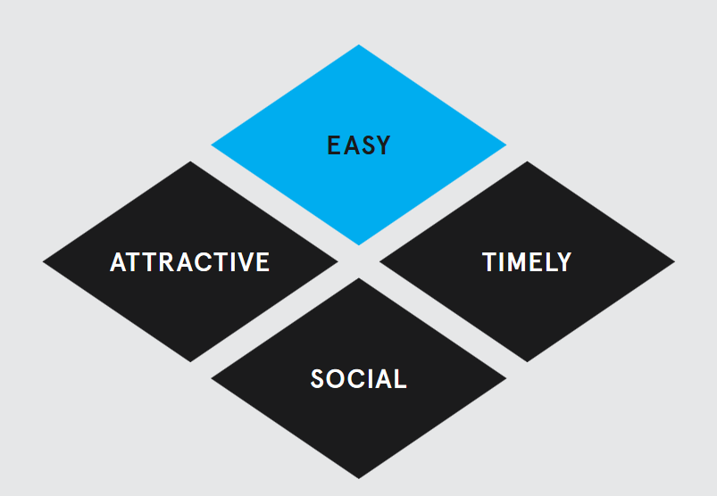
What to aim for from this weekend
(to use)
http://www.behaviouralinsights.co.uk/publications/east-four-simple-ways-to-apply-behavioural-insights/
Twitter @gmacscotland #PublicHealthPF

Slide 18
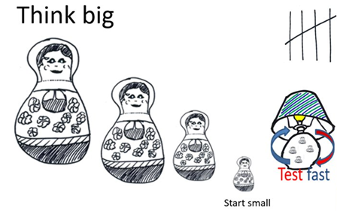
To conclude
There are not simple answers to complex problems (avoid “lifestyle drift”)
Think big, start small, test fast
Averages are the enemy of progress – go in deep
Routinely collected data are not usually enough
Twitter @gmacscotland #PublicHealthPF After Mayo CFI

