Slide 1
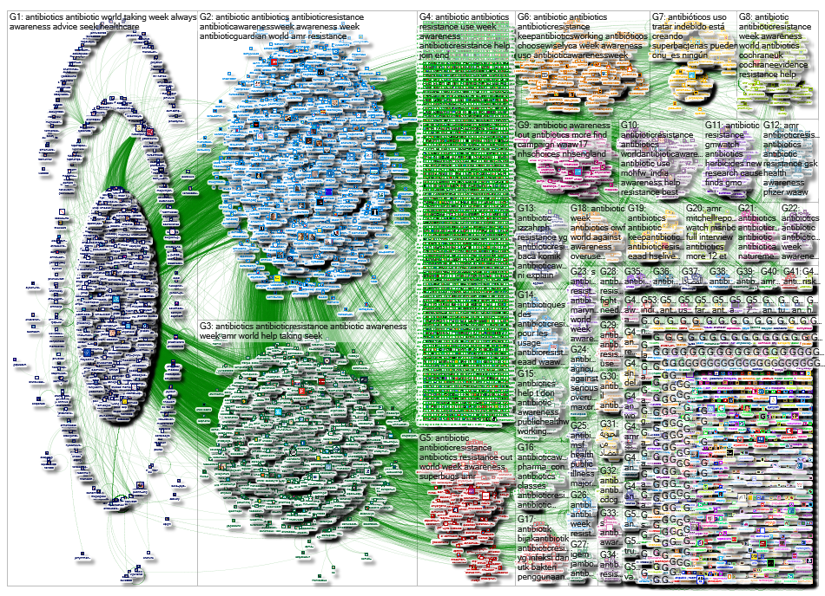
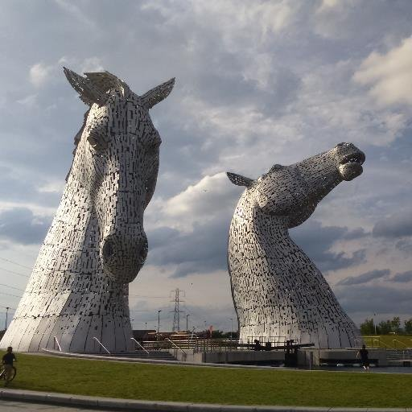
NodeXL
Social Media Network
Map & Report
for
World Antibiotic Awareness Week 13-19 November 2017

Slide 2
Contents
Network
Time Series
Description
Author Description
Overall Metrics
Top Influencers
Top URLs
Top Domains
Top Hashtags
Top Words
Top Word Pairs
Top Replied-To
Top Mentioned
Top Tweeters
Network

Slide 3
Contents
Network
Time Series
Description
Author Description
Overall Metrics
Top Influencers
Top URLs
Top Domains
Top Hashtags
Top Words
Top Word Pairs
Top Replied-To
Top Mentioned
Top Tweeters
Network
Not available

Slide 4
Search: #antibioticresistance OR #antibiotics OR #eaad OR #waaw OR #waaw17 OR #waaw2017 OR #antibioticawarenessweek OR #doit4das OR #antibioticguardian OR "antibiotic awareness week" OR "antibiotic resistance" OR #superbugs OR #keepantibioticsworking OR #AMR OR #WHSAvsAMR
13-19 November inclusive (except 09:07-10:42 on 14 Nov and 07:57-09:29 on 15 Nov)
The graph is directed.
The graph's vertices were grouped by cluster using the Clauset-Newman-Moore cluster algorithm.
The graph was laid out using the Harel-Koren Fast Multiscale layout algorithm.
Contents
Network
Time Series
Description
Author Description
Overall Metrics
Top Influencers
Top URLs
Top Domains
Top Hashtags
Top Words
Top Word Pairs
Top Replied-To
Top Mentioned
Top Tweeters
Network

Slide 5
Contents
Network
Time Series
Description
Author Description
Overall Metrics
Top Influencers
Top URLs
Top Domains
Top Hashtags
Top Words
Top Word Pairs
Top Replied-To
Top Mentioned
Top Tweeters
Network
Graham Mackenzie:
@gmacscotland on Twitter
Full data available on request

Slide 6
Vertices : 35270
Unique Edges : 43595
Edges With Duplicates : 69910
Total Edges : 113505
Self-Loops : 21280
Reciprocated Vertex Pair Ratio : 0.0265284641321606
Reciprocated Edge Ratio : 0.0516857838025721
Connected Components : 3963
Single-Vertex Connected Components : 3131
Maximum Vertices in a Connected Component : 29508
Maximum Edges in a Connected Component : 104491
Maximum Geodesic Distance (Diameter) : 14
Average Geodesic Distance : 3.853855
Graph Density : 4.62563384307298E-05
Modularity : 0.408927
NodeXL Version : 1.0.1.389
Contents
Network
Time Series
Description
Author Description
Overall Metrics
Top Influencers
Top URLs
Top Domains
Top Hashtags
Top Words
Top Word Pairs
Top Replied-To
Top Mentioned
Top Tweeters
Network

Slide 7










 | who
 | Tweet | Follow
 | cdcgov
 | Tweet | Follow
 | drdianeashiru
 | Tweet | Follow
 | phe_uk
 | Tweet | Follow
 | eaad_eu
 | Tweet | Follow
 | who_europe
 | Tweet | Follow
 | drcjlittle
 | Tweet | Follow
 | un
 | Tweet | Follow
 | onu_es
 | Tweet | Follow
 | faoknowledge
 | Tweet | Follow
Contents
Network
Time Series
Description
Author Description
Overall Metrics
Top Influencers
Top URLs
Top Domains
Top Hashtags
Top Words
Top Word Pairs
Top Replied-To
Top Mentioned
Top Tweeters
Network

Slide 8
Top URLs in Tweet in Entire Graph:
[368] | https://action.ciwf.org.uk/ea-action/action?ea.client.id=119&ea.campaign.id=80712&ea.tracking.id=a8368275&utm_campaign=antibiotics&utm_source=shared&utm_medium=twitter
[330] | https://www.nhs.uk/nhsengland/arc/pages/aboutarc.aspx
[283] | http://oms-platform.onebigrobot.com/en
[252] | http://who.int/infection-prevention/en/
[219] | http://antibioticguardian.com/
[184] | http://www.who.int/campaigns/world-antibiotic-awareness-week/quiz/en/
[176] | http://oms-platform.onebigrobot.com/en/experience
[174] | http://www.who.int/campaigns/world-antibiotic-awareness-week/en/
[171] | http://www.fao.org/antimicrobial-resistance/world-antibiotic-awareness-week/en/?utm_content=buffer110a7&utm_medium=social&utm_source=twitter.com&utm_campaign=buffer
[149] | http://www.who.int/foodsafety/areas_work/food-hygiene/AMR-food-infographics/en/
Contents
Network
Time Series
Description
Author Description
Overall Metrics
Top Influencers
Top URLs
Top Domains
Top Hashtags
Top Words
Top Word Pairs
Top Replied-To
Top Mentioned
Top Tweeters
Network

Slide 9
Top Domains in Tweet in Entire Graph:
[13992] | twitter.com
[1648] | who.int
[542] | cdc.gov
[535] | youtube.com
[508] | ac.uk
[464] | onebigrobot.com
[449] | nhs.uk
[446] | org.uk
[335] | antibioticguardian.com
[330] | fb.me
Contents
Network
Time Series
Description
Author Description
Overall Metrics
Top Influencers
Top URLs
Top Domains
Top Hashtags
Top Words
Top Word Pairs
Top Replied-To
Top Mentioned
Top Tweeters
Network

Slide 10
Top Hashtags in Tweet in Entire Graph:
[19899] | antibioticresistance
[7084] | antibiotics
[6454] | antibioticawarenessweek
[6056] | amr
[4424] | keepantibioticsworking
[2938] | antibioticguardian
[2856] | waaw
[2787] | waaw2017
[2680] | eaad
[1861] | stopsuperbugs
Contents
Network
Time Series
Description
Author Description
Overall Metrics
Top Influencers
Top URLs
Top Domains
Top Hashtags
Top Words
Top Word Pairs
Top Replied-To
Top Mentioned
Top Tweeters
Network

Slide 11
Top Words in Tweet in Entire Graph:
[29484] | Words in Sentiment List#1: Positive
[32367] | Words in Sentiment List#2: Negative
[347] | Words in Sentiment List#3: Angry/Violent
[1129897] | Non-categorized Words
[1191751] | Total Words
[25389] | antibiotics
[24076] | antibiotic
[19921] | antibioticresistance
[14301] | awareness
[13753] | week
Contents
Network
Time Series
Description
Author Description
Overall Metrics
Top Influencers
Top URLs
Top Domains
Top Hashtags
Top Words
Top Word Pairs
Top Replied-To
Top Mentioned
Top Tweeters
Network

Slide 12
Top Word Pairs in Tweet in Entire Graph:
[12463] | antibiotic,awareness
[12117] | awareness,week
[10069] | world,antibiotic
[7350] | taking,antibiotics
[6680] | seek,advice
[6571] | antibiotic,resistance
[6007] | always,seek
[5948] | advice,qualified
[5946] | before,taking
[5903] | professional,before
Contents
Network
Time Series
Description
Author Description
Overall Metrics
Top Influencers
Top URLs
Top Domains
Top Hashtags
Top Words
Top Word Pairs
Top Replied-To
Top Mentioned
Top Tweeters
Network

Slide 13







 | who
 | Tweet | Follow
 | cdcgov
 | Tweet | Follow
 | elizbeech
 | Tweet | Follow
 | guiaprioam
 | Tweet | Follow
 | mfda_mv
 | Tweet | Follow
 | longitude_prize
 | Tweet | Follow
 | hpa_mv
 | Tweet | Follow
 | ncdcgov
 | Tweet | Follow
 | drcjlittle
 | Tweet | Follow
 | biochemsoc
 | Tweet | Follow
Contents
Network
Time Series
Description
Author Description
Overall Metrics
Top Influencers
Top URLs
Top Domains
Top Hashtags
Top Words
Top Word Pairs
Top Replied-To
Top Mentioned
Top Tweeters
Network

Slide 14


 | who
 | Tweet | Follow
 | cdcgov
 | Tweet | Follow
 | phe_uk
 | Tweet | Follow
 | drtedros
 | Tweet | Follow
 | eaad_eu
 | Tweet | Follow
 | who_europe
 | Tweet | Follow
 | drdianeashiru
 | Tweet | Follow
 | faoknowledge
 | Tweet | Follow
 | cochraneuk
 | Tweet | Follow
 | un
 | Tweet | Follow
Contents
Network
Time Series
Description
Author Description
Overall Metrics
Top Influencers
Top URLs
Top Domains
Top Hashtags
Top Words
Top Word Pairs
Top Replied-To
Top Mentioned
Top Tweeters
Network

Slide 15
Contents
Network
Time Series
Description
Author Description
Overall Metrics
Top Influencers
Top URLs
Top Domains
Top Hashtags
Top Words
Top Word Pairs
Top Replied-To
Top Mentioned
Top Tweeters
Network
Not available

Slide 16
Contents
Network
Time Series
Description
Author Description
Overall Metrics
Top Influencers
Top URLs
Top Domains
Top Hashtags
Top Words
Top Word Pairs
Top Replied-To
Top Mentioned
Top Tweeters
Network

Slide 17
NodeXL
Social Media Network
Map & Report
for
World Antibiotic Awareness Week 13-19 November 2017

