Slide 1

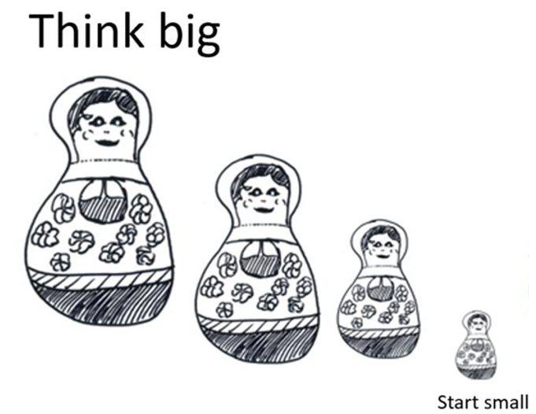

Quality Improvement: Designing the jargon out, creatively
Graham Mackenzie
Consultant in Public Health, NHS Lothian
@gmacscotland

Slide 2
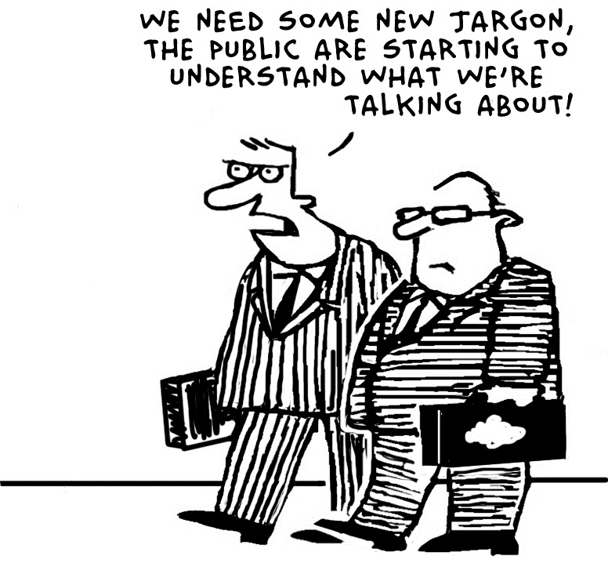
http://www.ecommplish.com/blog/ecommerce-jargon-buster-episode-21

Slide 3
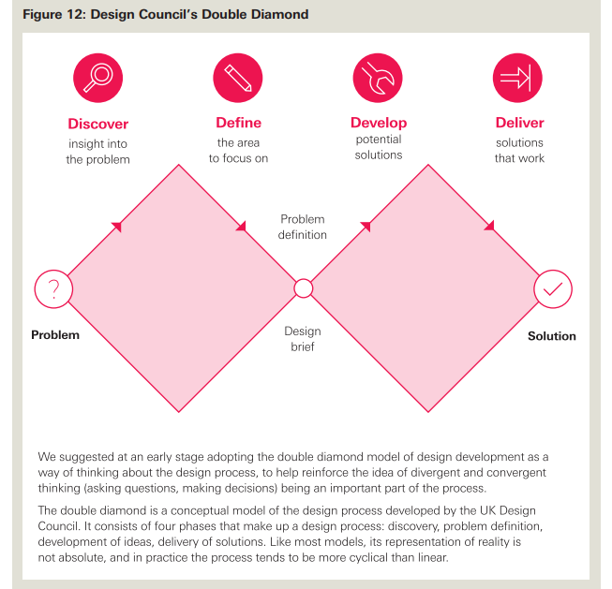
http://www.health.org.uk/sites/health/files/BuildingQ.pdf
Notes:
Design diamonds

Slide 4
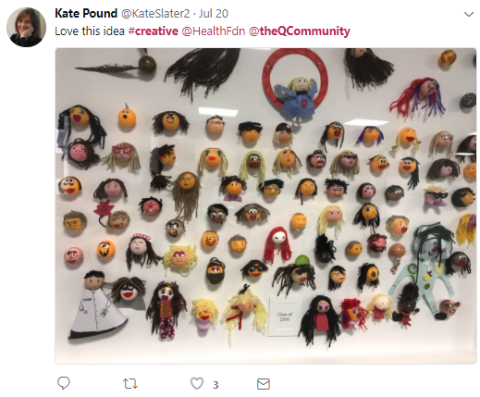

Slide 5
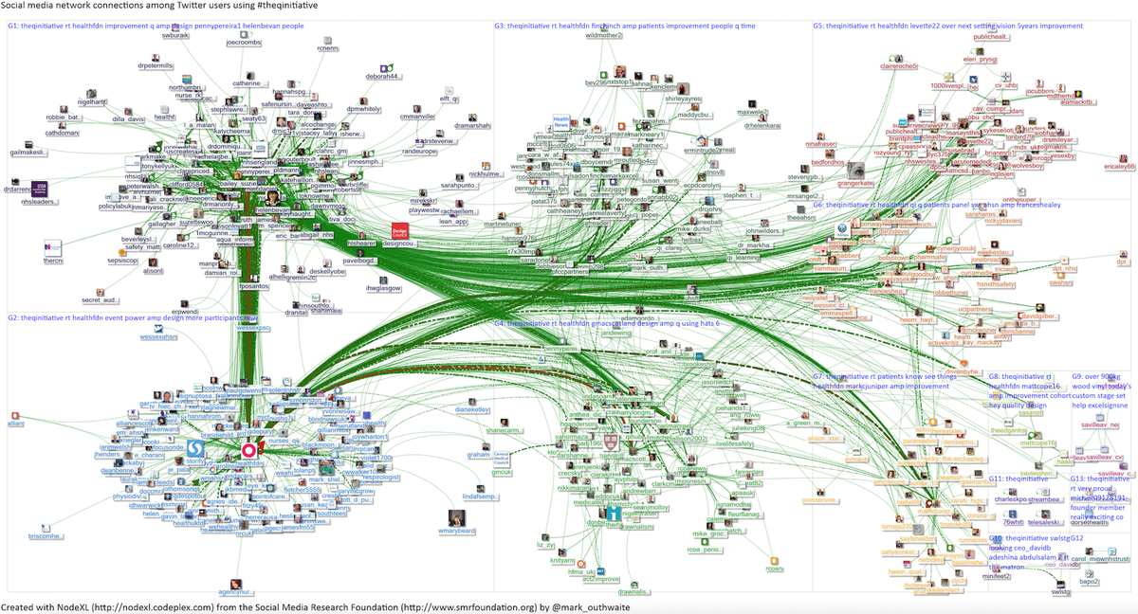
“Birth of an emerging network” (24 July 2015)
#TheQInitiative NodeXL, July 2015, Via @Mark_outhwaite
Notes:
Connections map

Slide 6
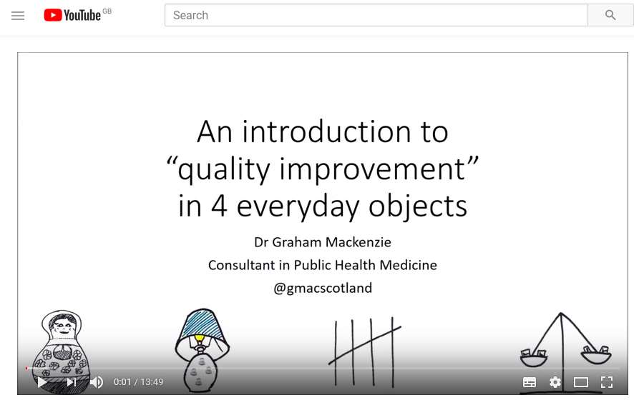
ScotPublicHealth.com @gmacscotland

Slide 7
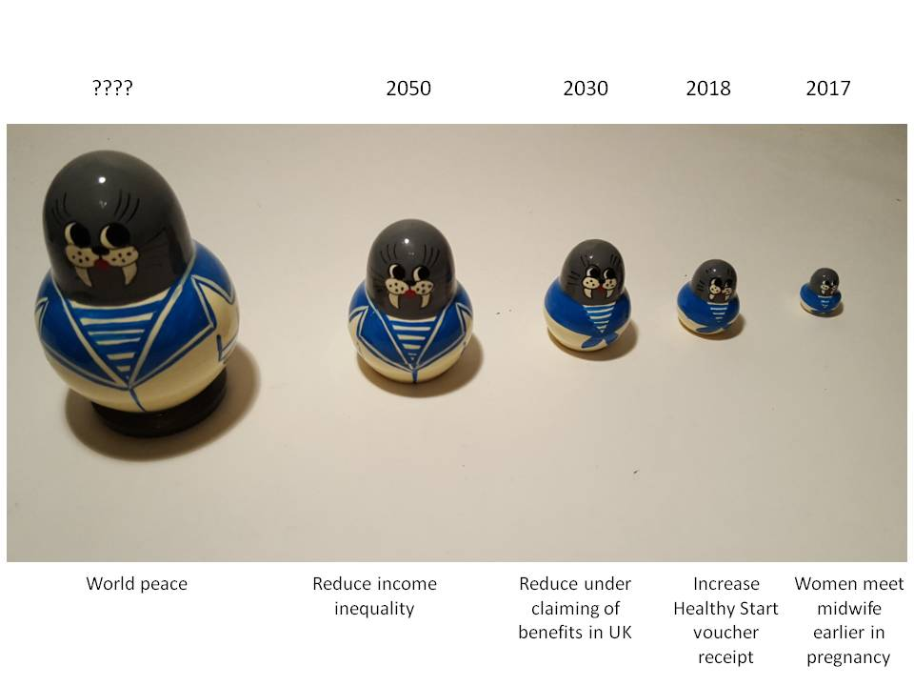

Slide 8
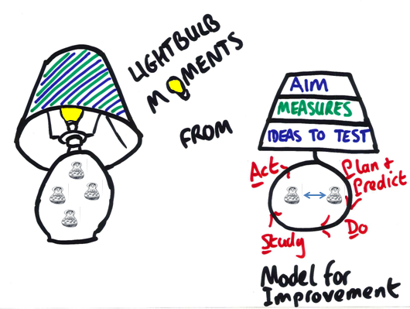

Slide 9
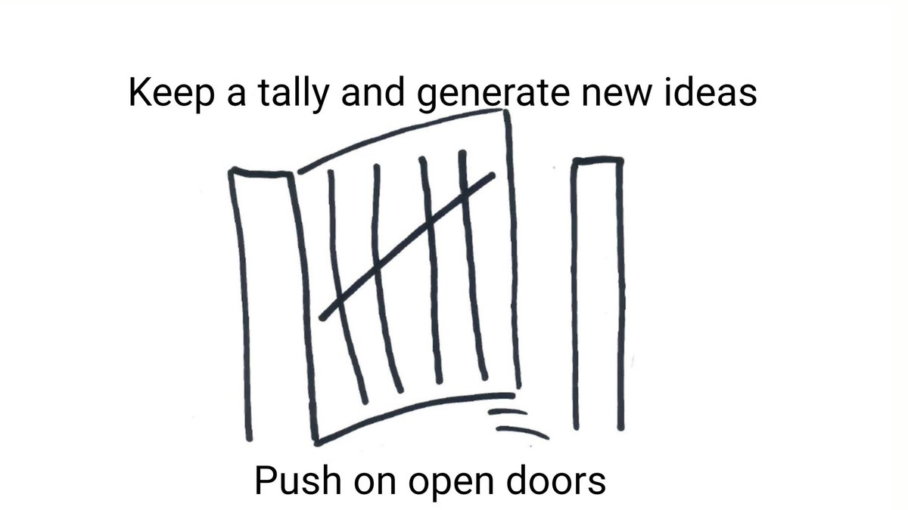

Slide 10
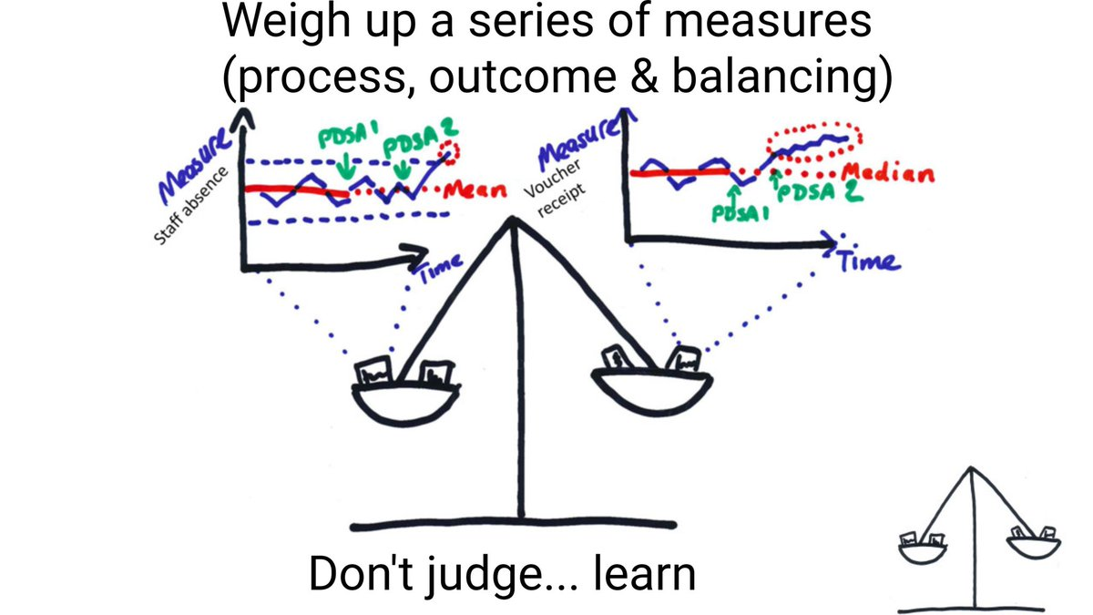

Slide 11
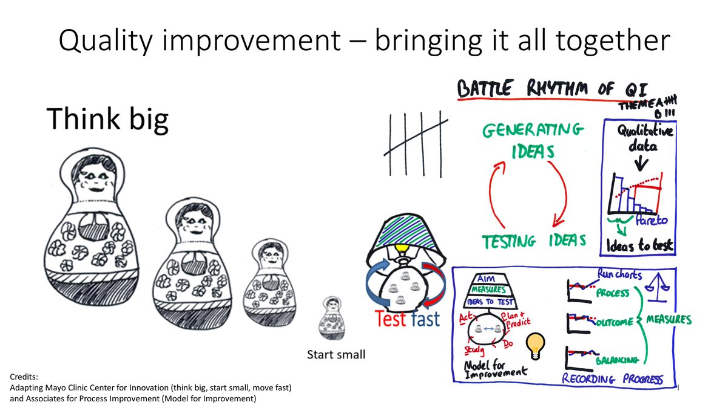

Slide 13

Creativity?
Connectivity?
Impact?
Utility?
Simplicity?

Slide 14

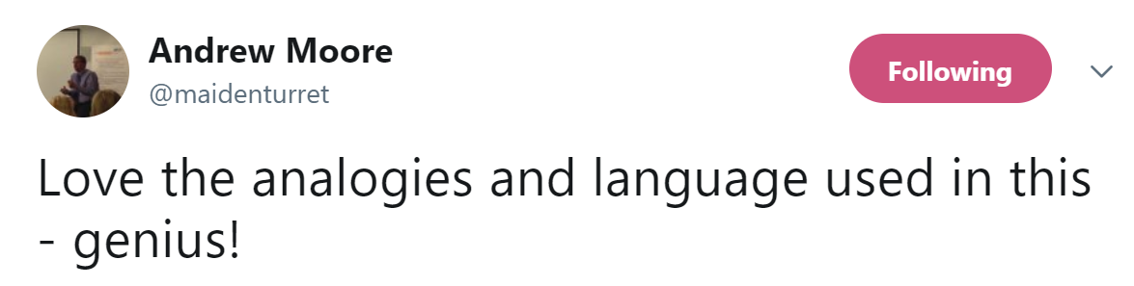


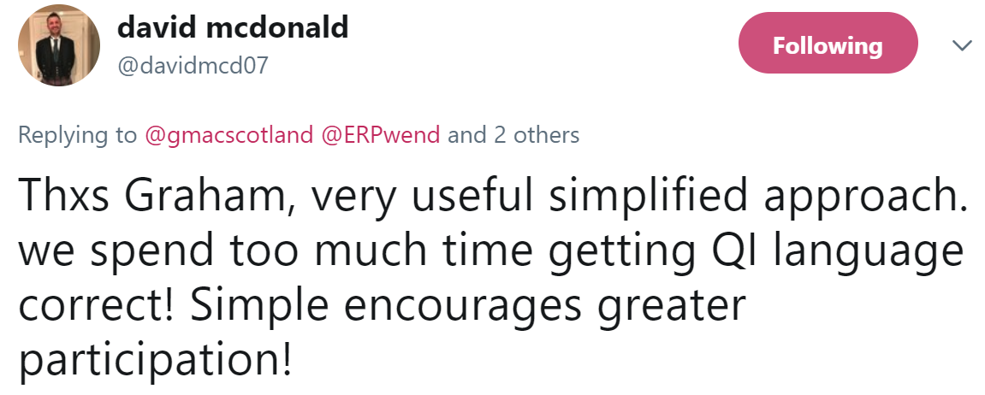
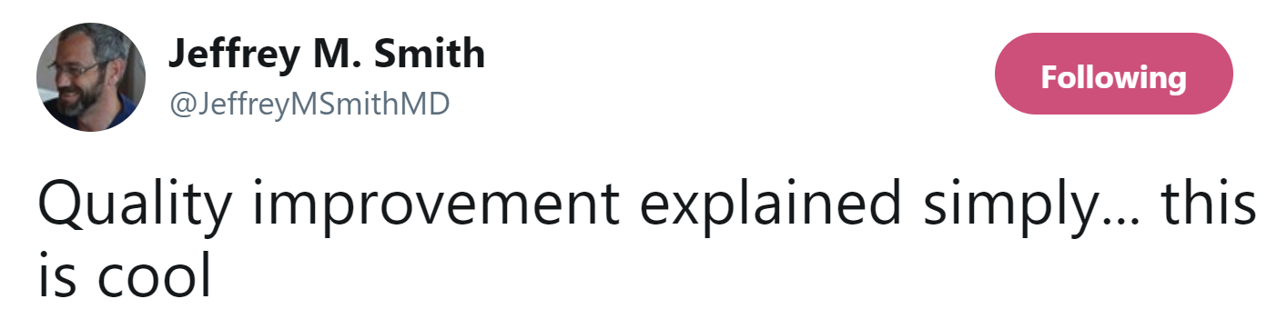

Slide 15
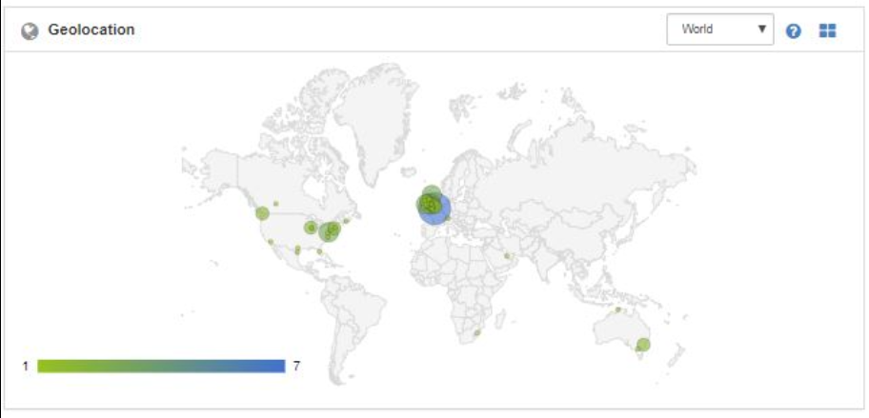
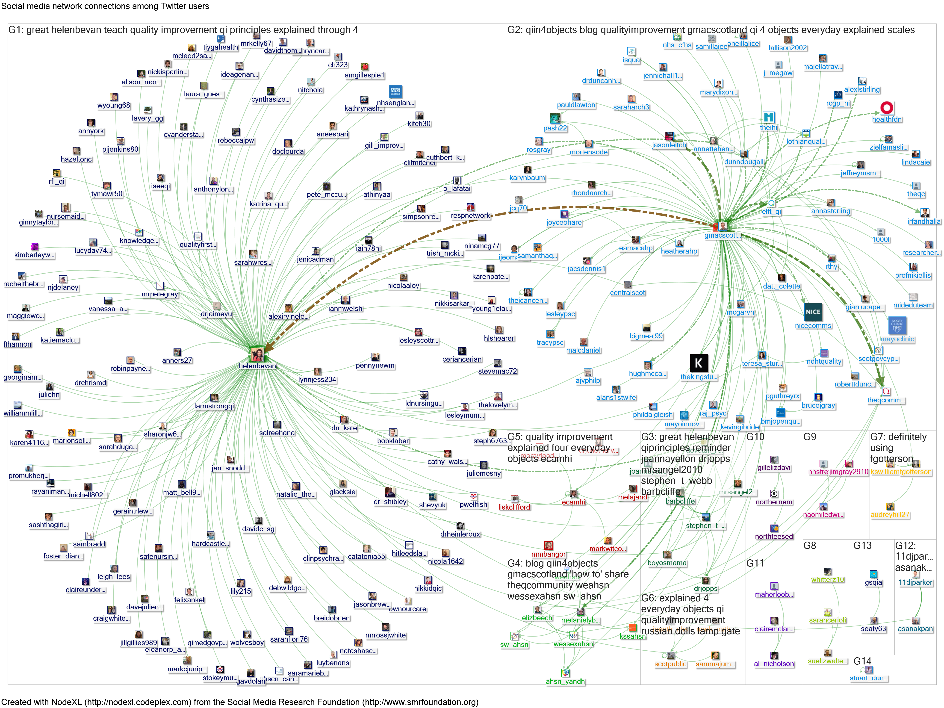
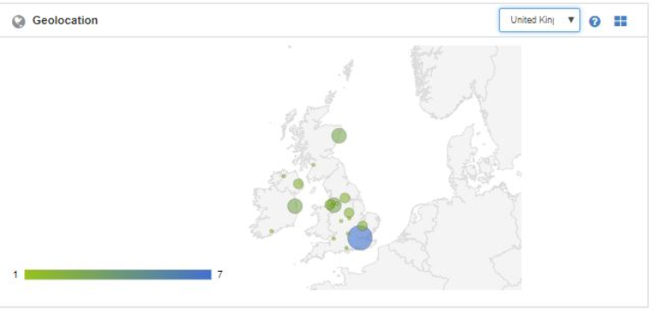

Slide 16
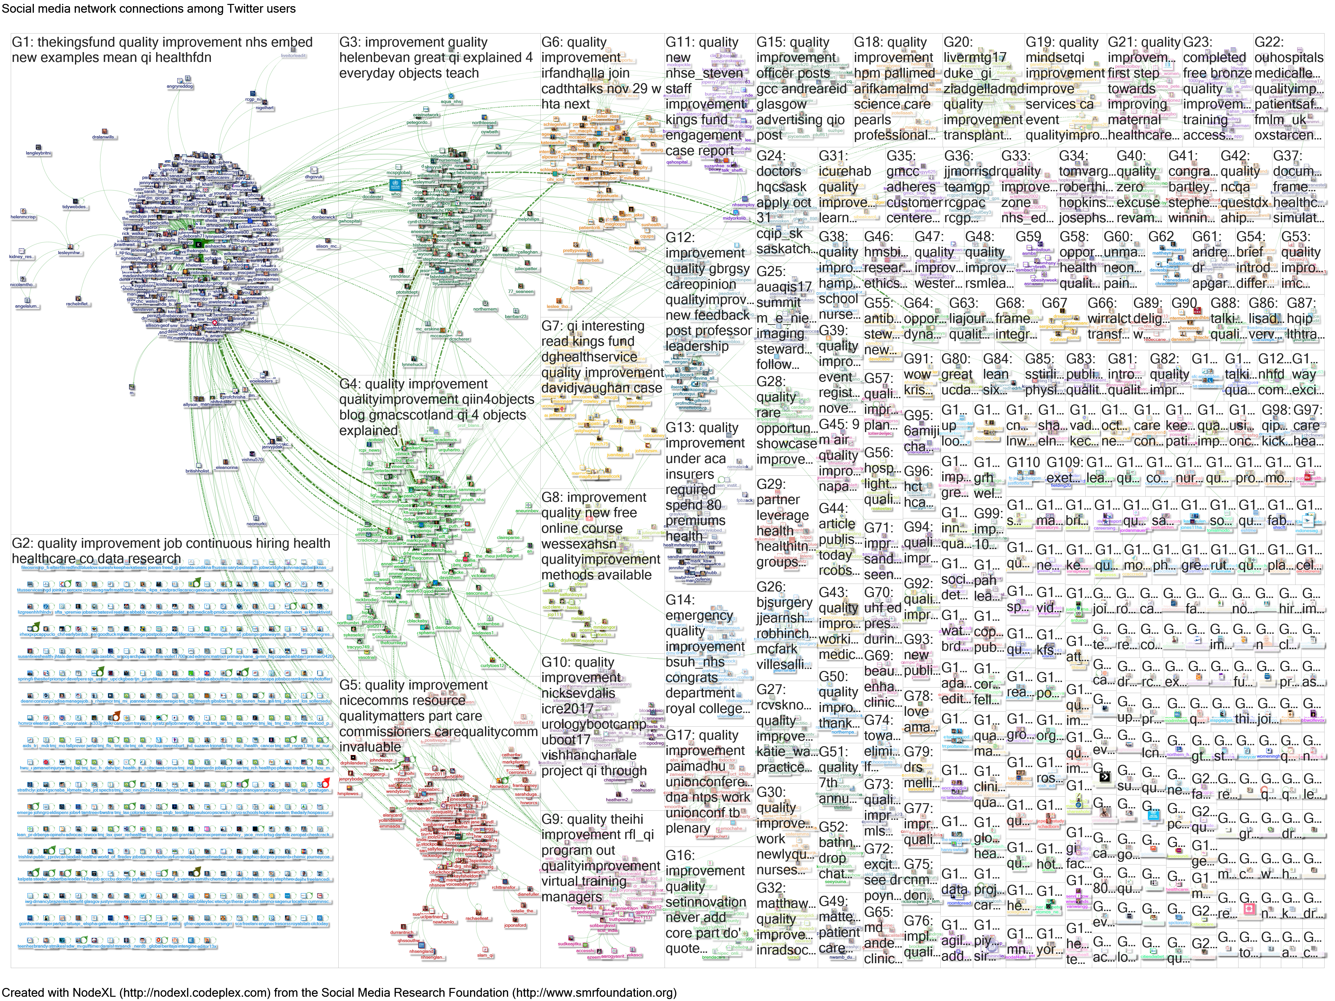
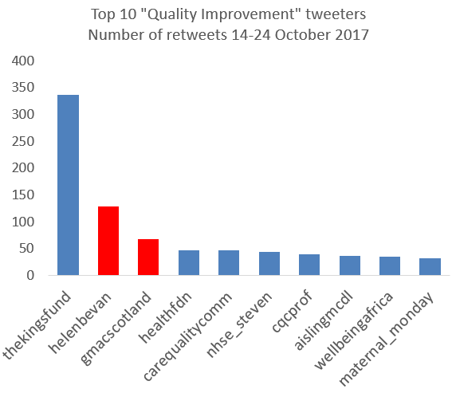
10% of all QI tweets for these 10 days

Slide 17
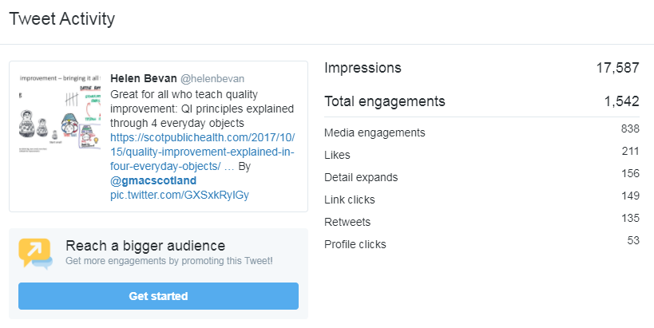

Slide 18
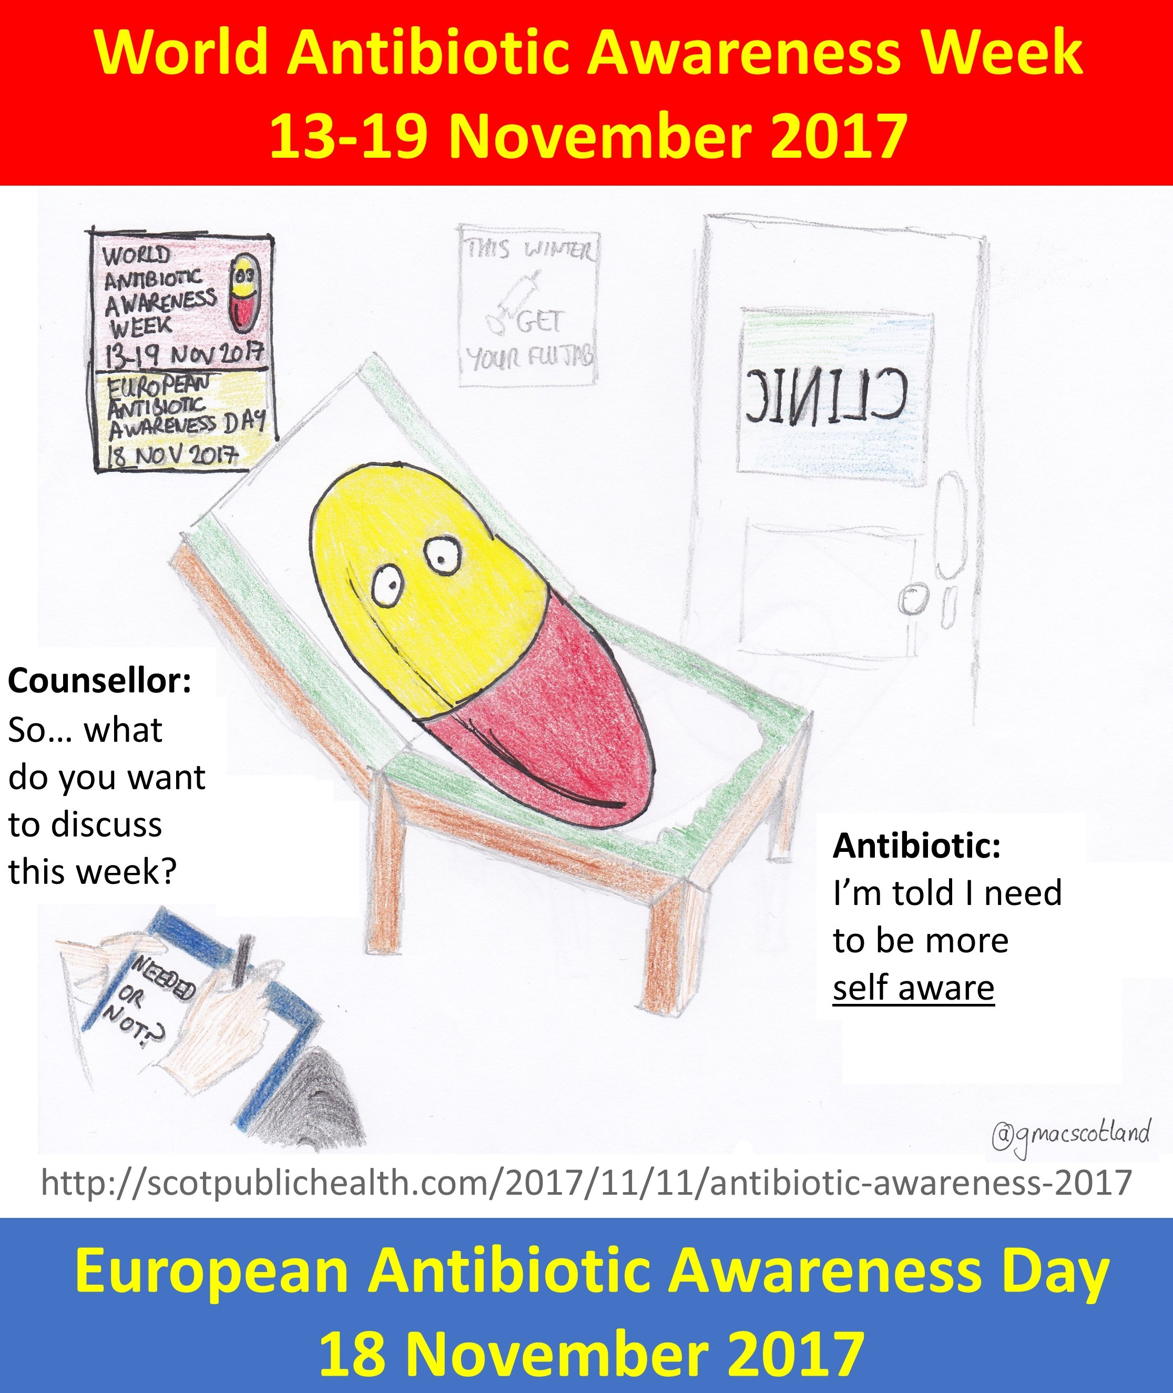
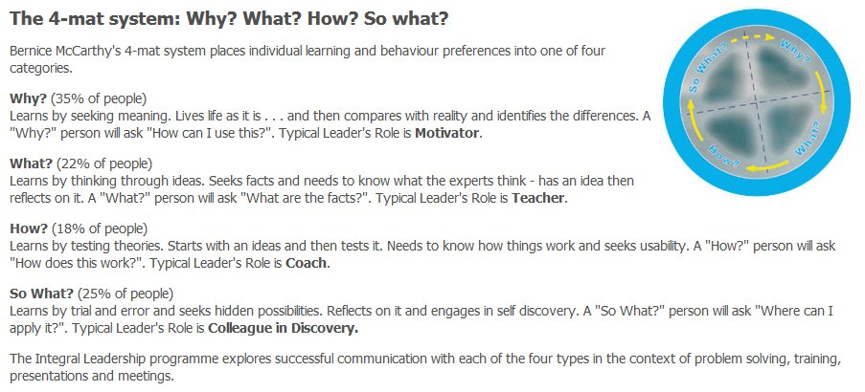
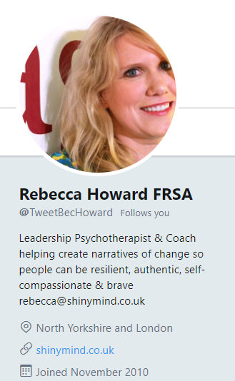

Slide 19
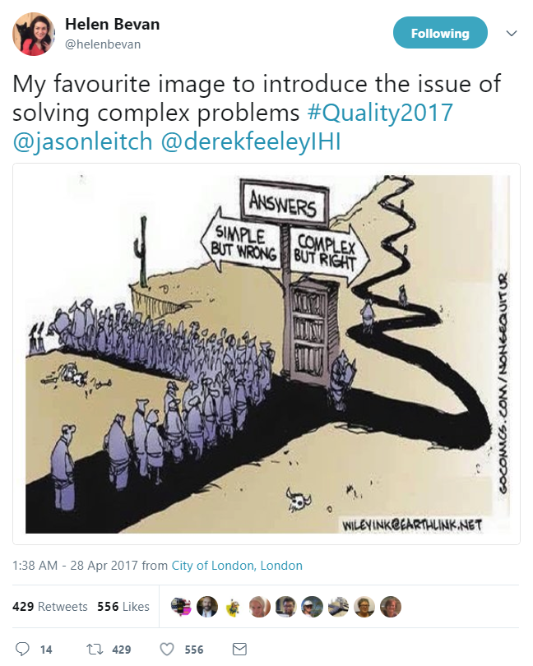

Slide 20
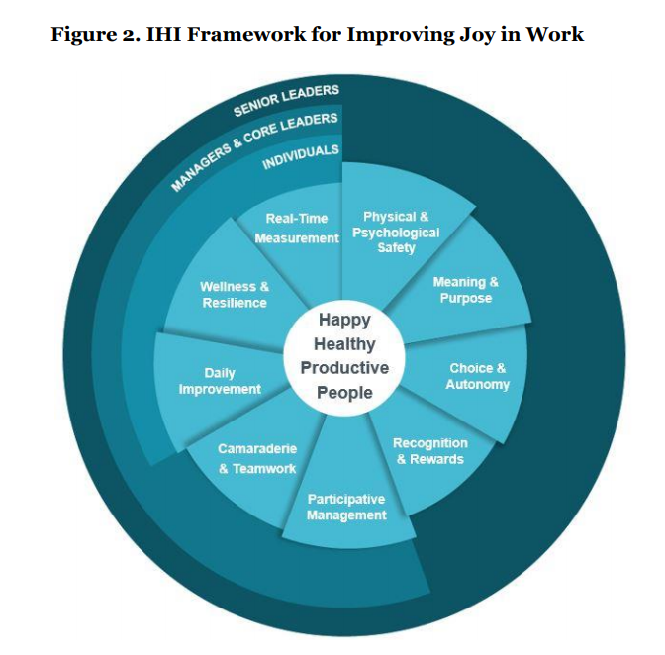

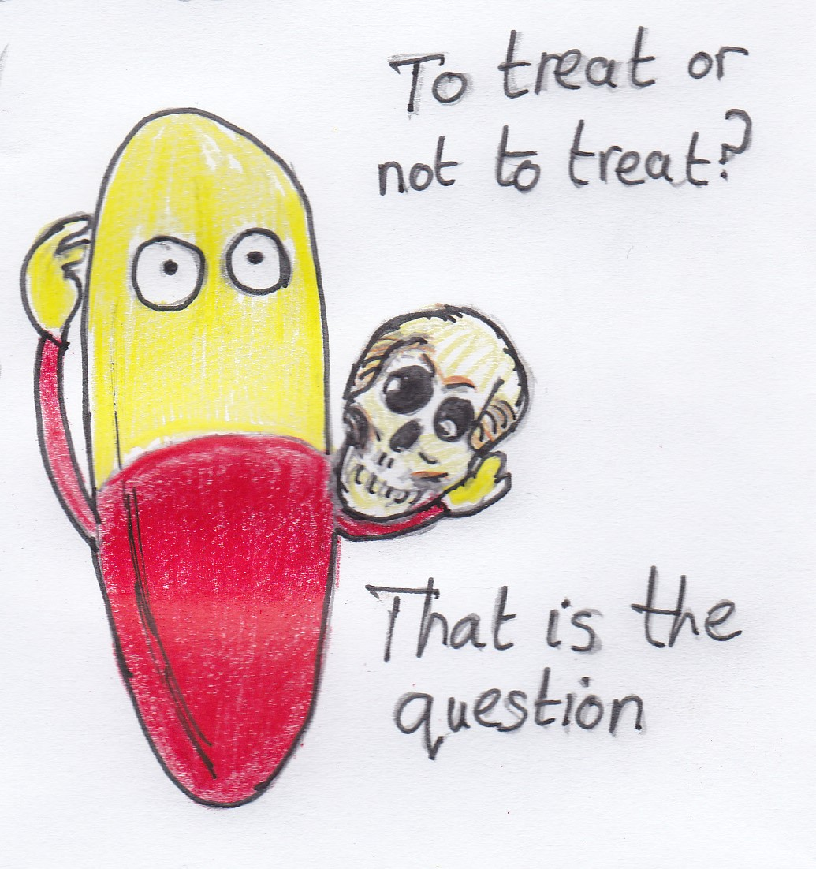

http://www.ihi.org/resources/Pages/IHIWhitePapers/Framework-Improving-Joy-in-Work.aspx IHI 2017

Slide 21

More information online: www.scotpublichealth.com
Email: gm@nhs.net
Follow on Twitter: @gmacscotland

