Slide 1
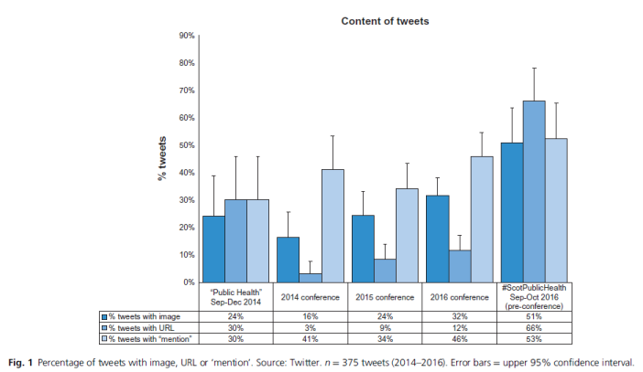
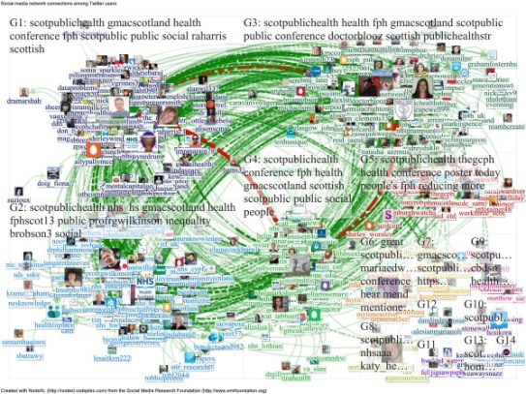

Improving the quality and impact of public health tweeting in Scotland: #ScotPublicHealth
For #EPHStockholm, Nov 2017
Dr Graham Mackenzie
Consultant in Public Health Medicine
NHS Lothian
@gmacscotland

Slide 2


Why bother with social media?
Learning
Networking
Broadcasting
@ScotPublic
@gmacscotland

Slide 3

Purpose of this study
After the Scottish Public Health conference in November 2015 I set out to connect Public Health colleagues across Scotland through Twitter
Initial attempts via Twitter alone had little impact
Using a blog, a new Twitter account and a series of webinar I set out to learn and share ideas about Public Health and social media & study impact
Activities focused around #ScotPublicHealth

Slide 4
Assessing quality of tweets

Slide 5

Quality of tweets: results (3 tweets/user)

Slide 6
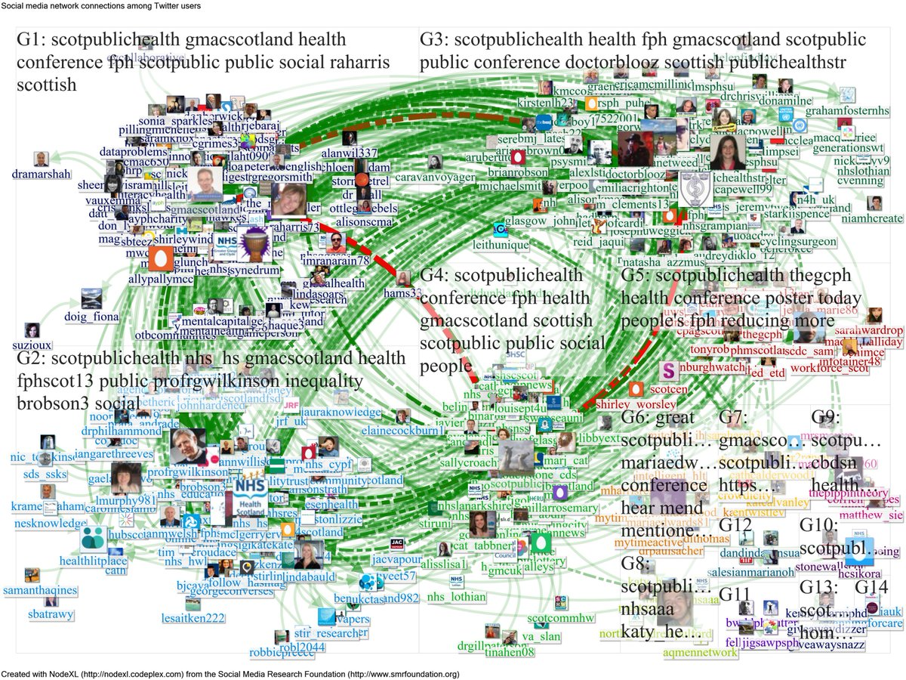
Impact of tweets

Slide 7
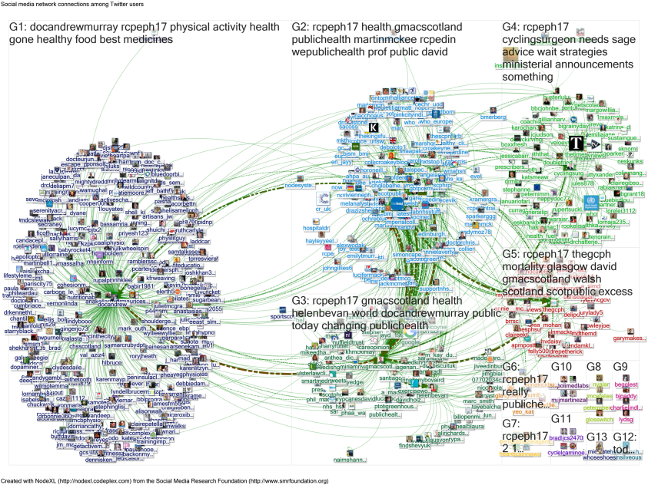
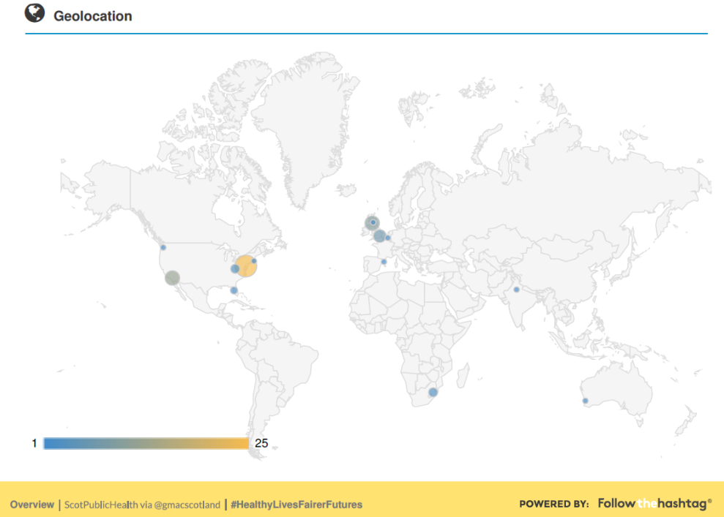
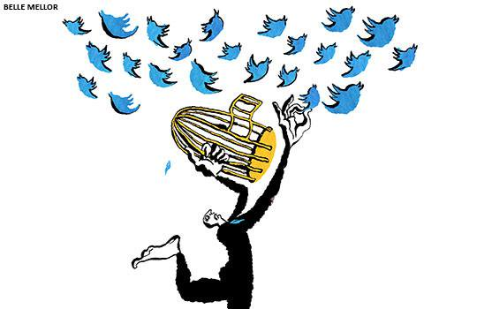

Lasting impact: beyond #ScotPublicHealth
Have used methods learnt, and networks developed through this work to disseminate Scottish Public Health work widely – in conferences & advocacy
I have refined social network analysis techniques to look at conferences & public health awareness campaigns
Method even reached the front cover of the BMJ (9 Sep 2017)

Slide 8
Conclusions
We have executed, studied and published a national approach to improving quality and impact of public health tweeting
General Public Health tweeting in Scotland has improved (quality & impact), but conference tweeting not so much (national conference)
There are wider benefits to understanding how Twitter works
In addition to “networking”, “learning” and “broadcasting”, I would add “analysing” to Public Health functions on Twitter
JPH: https://academic.oup.com/jpubhealth/article-abstract/doi/10.1093/pubmed/fdx066/3862396/Improving-the-quality-and-impact-of-public-health
Blog: www.scotpublichealth.com

