Slide 1
What is the role of Public Health doctors in tackling contemporary health problems?
Dr Graham Mackenzie
Consultant in Public Health Medicine, NHS Lothian
@gmacscotland on Twitter www.scotpublichealth.com

Slide 2
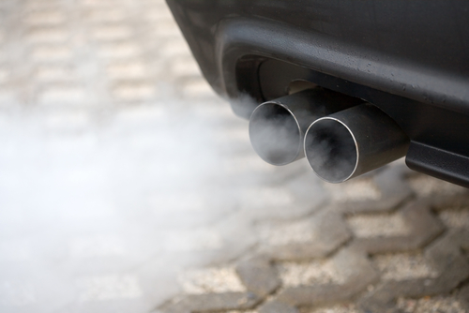
Look at this photo
What are your first thoughts?
Notes:
A starting slide for reflection and feedback
Looking for some feedback about recent news stories about diesel, NOx and particulate matter and health, and inequalities

Slide 3

What more would you want to know before taking action on air pollution and health?
Notes:
An opportunity to introduce time, place and person framework for epidemiology – using next few slides to evidence points for air pollution, before moving on to Bradford Hill’s criteria

Slide 4
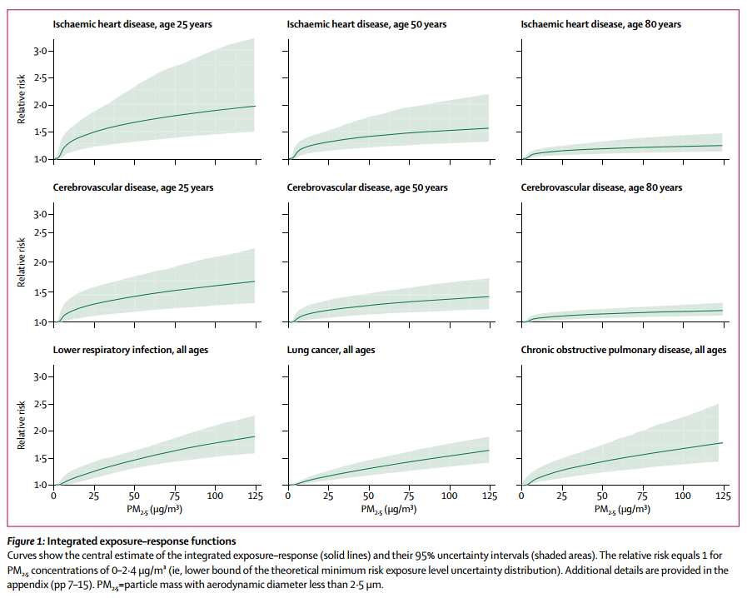
http://thelancet.com/pdfs/journals/lancet/PIIS0140-6736(17)30505-6.pdf
Notes:
Air pollution has wide effects, with clear dose response

Slide 5
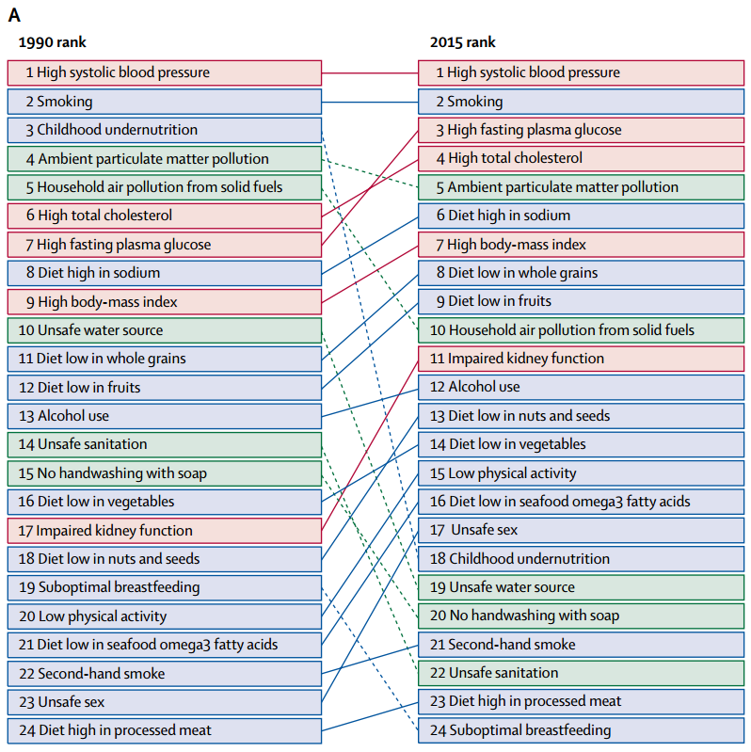
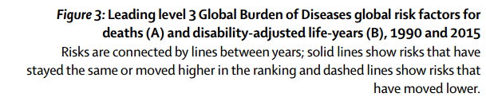
http://thelancet.com/pdfs/journals/lancet/PIIS0140-6736(17)30505-6.pdf
Notes:
Air pollution is a leading cause of ill health globally

Slide 6
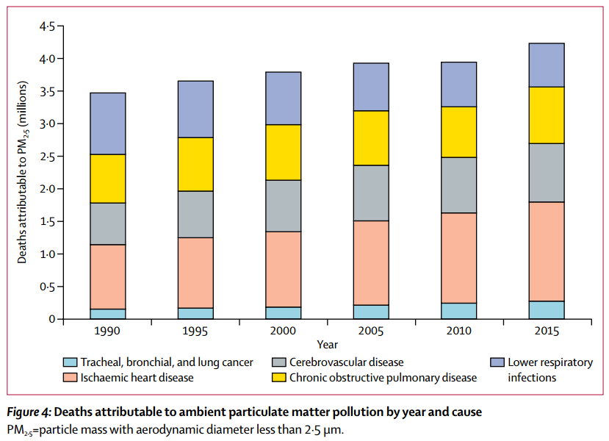
http://thelancet.com/pdfs/journals/lancet/PIIS0140-6736(17)30505-6.pdf
Notes:
The impact of air pollution appears to be increasing – what else would you want to know

Slide 7
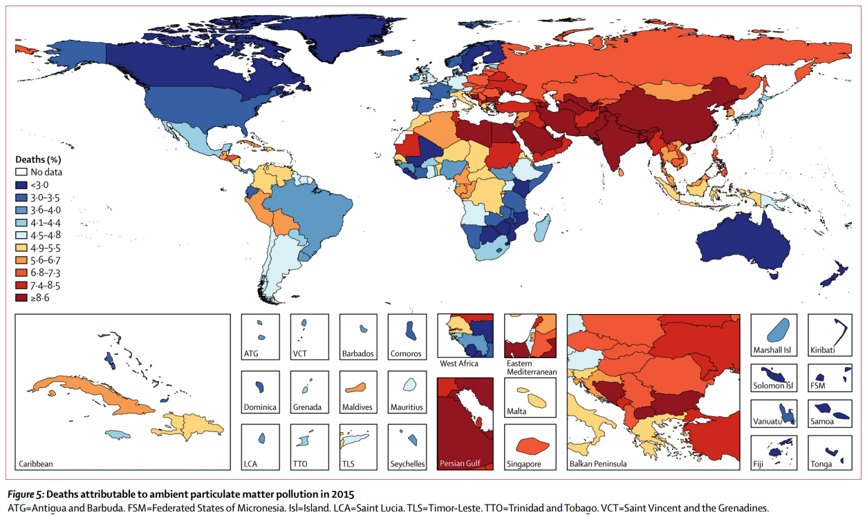
http://thelancet.com/pdfs/journals/lancet/PIIS0140-6736(17)30505-6.pdf
Notes:
There are many worse places for deaths caused by particulate matter, but that doesn’t mean that we should be complacent

Slide 8
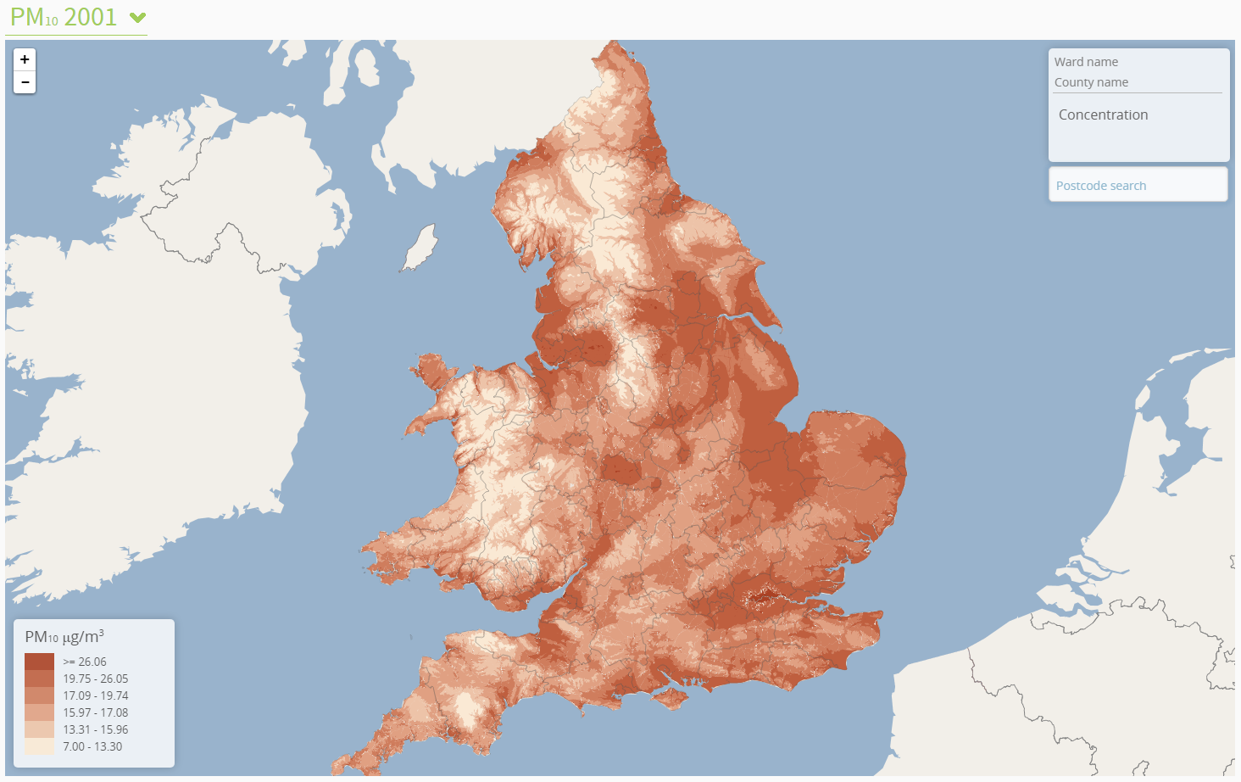
http://www.envhealthatlas.co.uk/homepage/
Notes:
Look at massive variation when looking at data at small area level

Slide 9
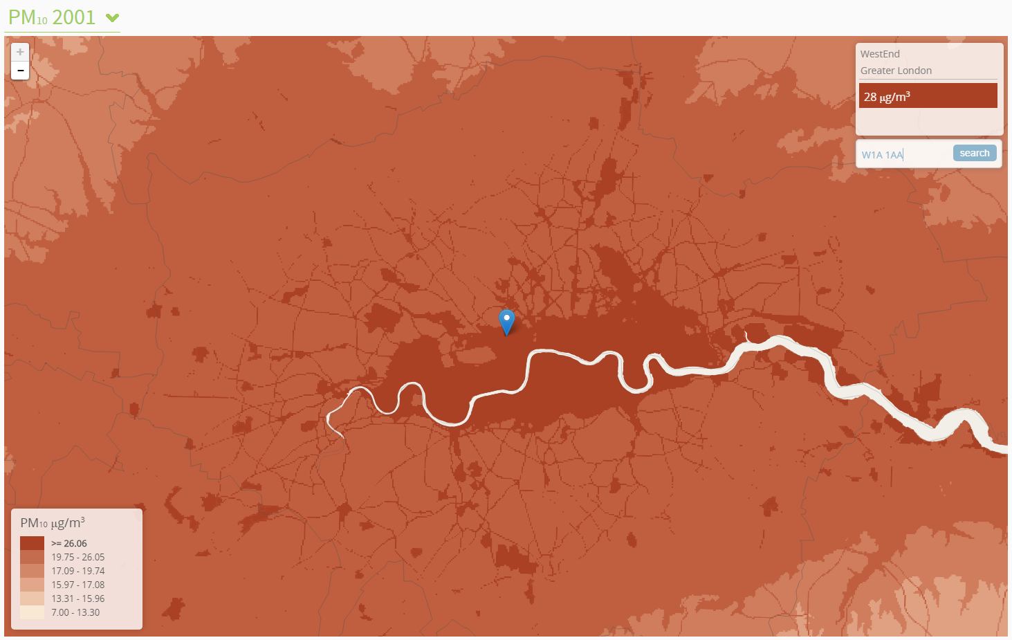
http://www.envhealthatlas.co.uk/homepage/
Notes:
These are the figures around BBC Broadcasting House, London

Slide 10
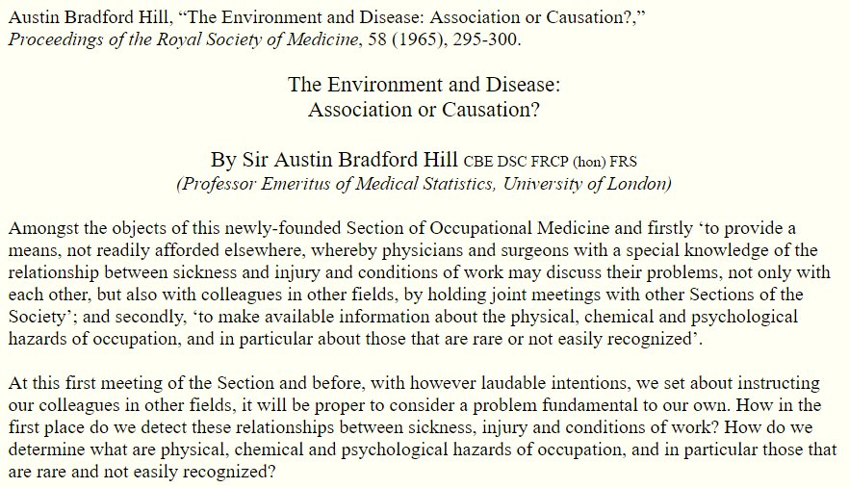
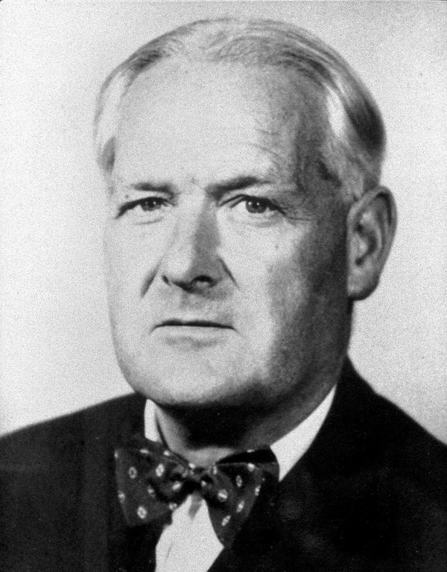
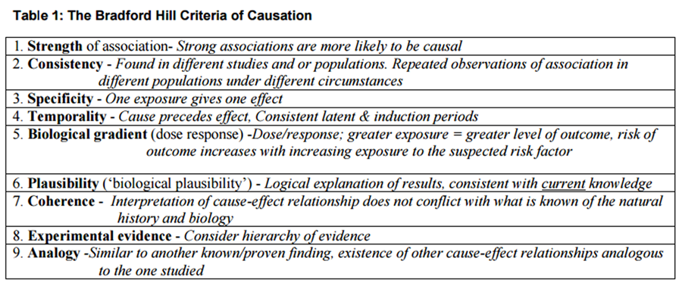
https://www.edwardtufte.com/tufte/hill
Notes:
Reflect on the previous slides in light of Bradford Hill’s criteria. Then move on to describe where these criteria came from (next two slides)

Slide 11
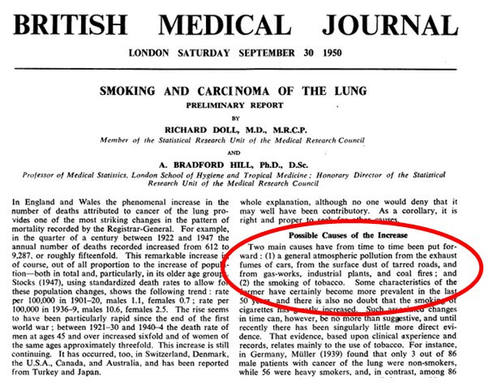
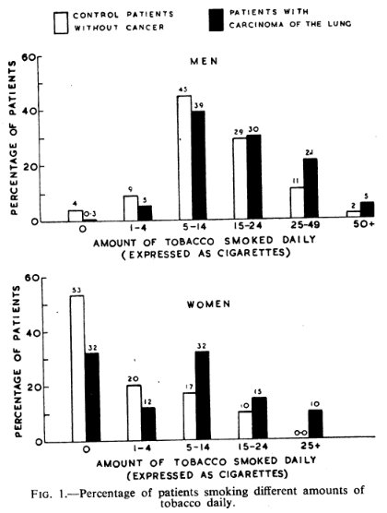
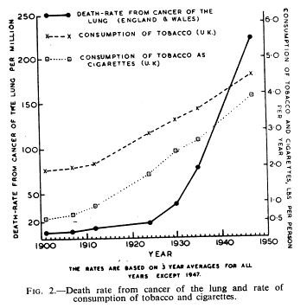
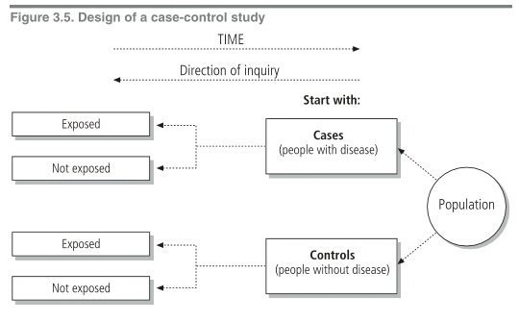
https://www.ncbi.nlm.nih.gov/pmc/articles/PMC2038856/?page=1
Notes:
A quick explanation of case control studies, with reflections on why this is less powerful than prospective studies (see temporality on previous slide)

Slide 12
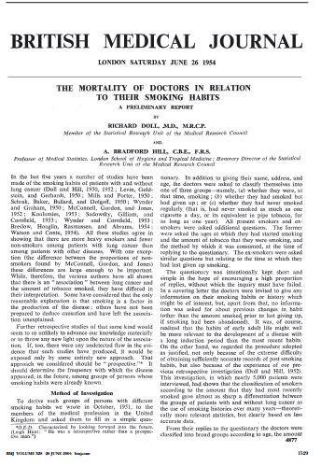
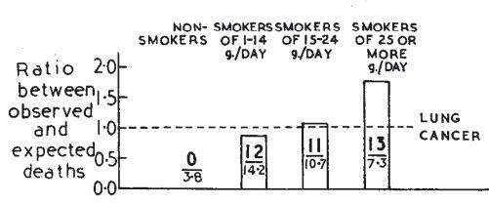
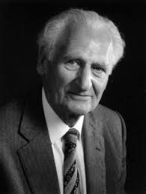

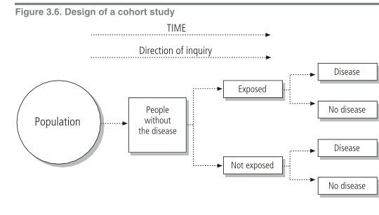
http://www.bmj.com/content/328/7455/1529
Notes:
A quick skip through cohort studies

Slide 13

http://apps.who.int/iris/handle/10665/43541
Notes:
An excellent free resource for further reading

Slide 14
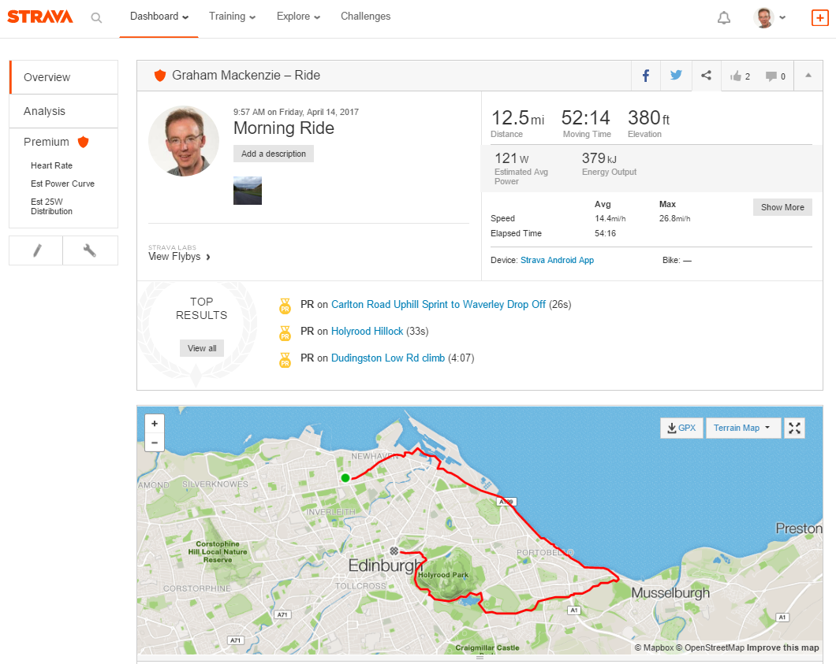
What is our role? Do we lead by example?

Slide 15
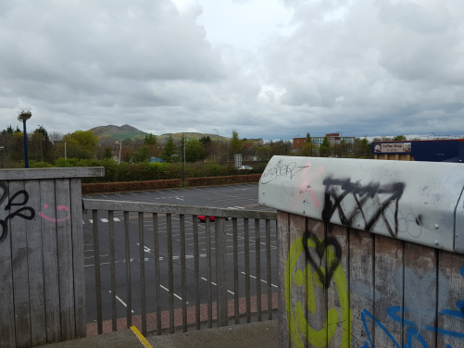
Notes:
Personal experience will give us insights into what we want to improve, but may not even influence our own family’s behaviour let alone that of patients and public

Slide 16
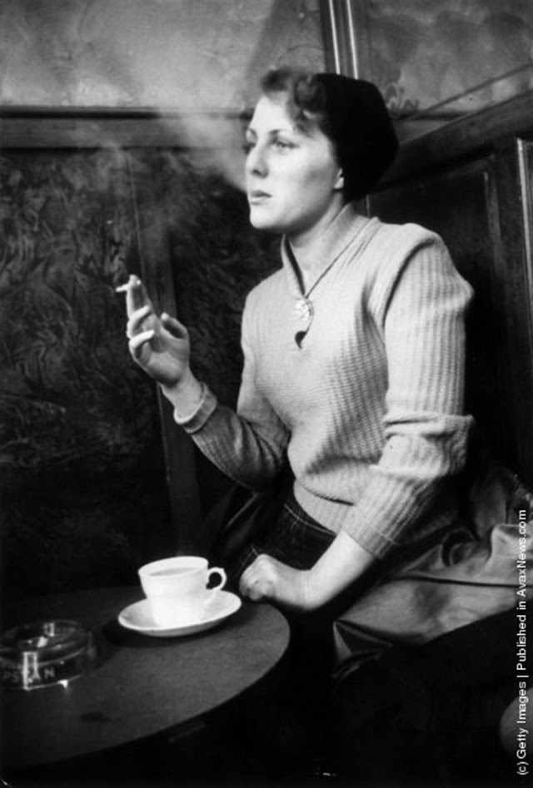
Or do we start trying to reduce smoking one person at a time?
Notes:
!

Slide 17
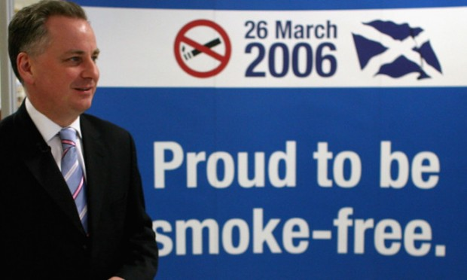
Notes:
Reflect on reasons why it took so long to go from Doll and Bradford Hill’s classic studies to ban on smoking in enclosed public places

Slide 18
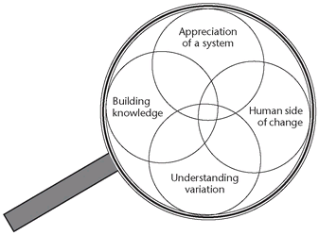
Edwards Deming’s lens of profound knowledge
http://ihub.scot/2020-framework-for-quality-efficiency-and-value/improve/deming-s-system-of-profound-knowledge/
Notes:
LOPK is a theory of management that provides a framework of thought and action for any leader wishing to transform or improve their team or organisation and consists of four components, or 'lenses' through which to view the world simultaneously

Slide 19
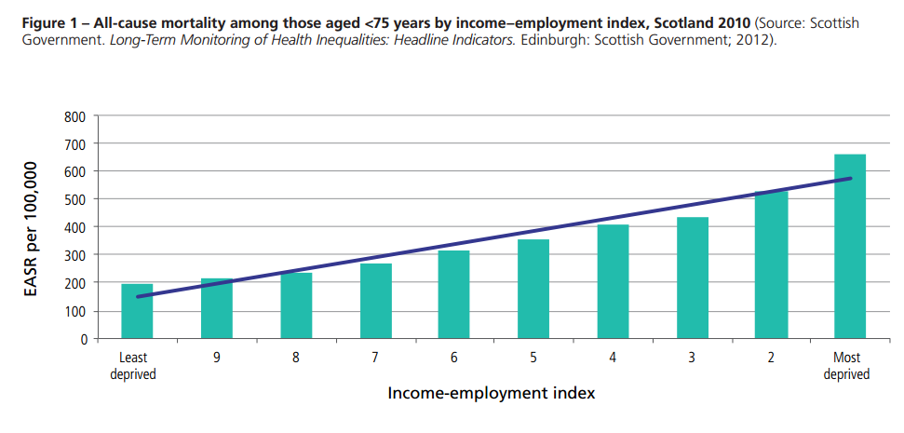
http://www.healthscotland.com/uploads/documents/24296-ProportionateUniversalismBriefing.pdf
Notes:
Move on to introduce some key concepts around inequalities – here gap and gradient

Slide 20

http://www.instituteofhealthequity.org/projects/fair-society-healthy-lives-the-marmot-review (2010)
Notes:
Marmot Review 2010 introduced two concepts we’ll explore further today – proportionate universalism and lifestyle drift

Slide 21
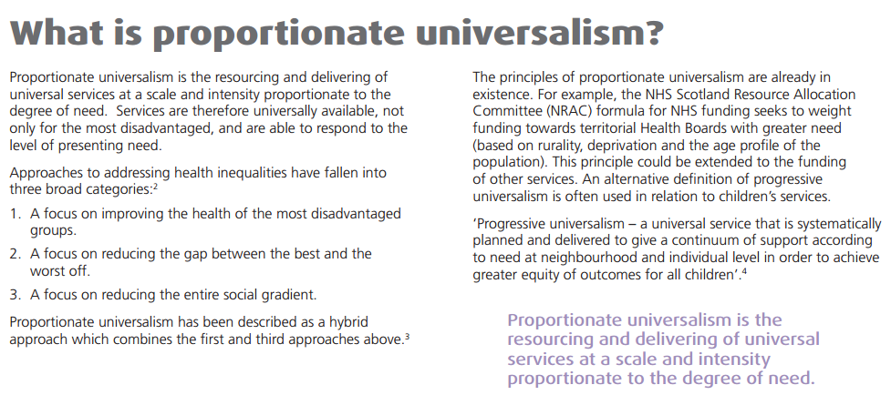
http://www.healthscotland.com/uploads/documents/24296-ProportionateUniversalismBriefing.pdf

Slide 22
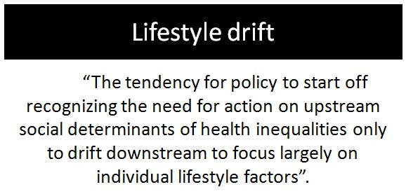
https://academic.oup.com/jpubhealth/article/32/2/148/1610540/Injustice-is-killing-people-on-a-large-scale-but

Slide 23
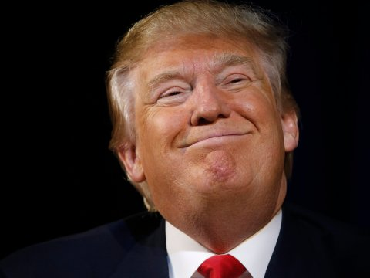
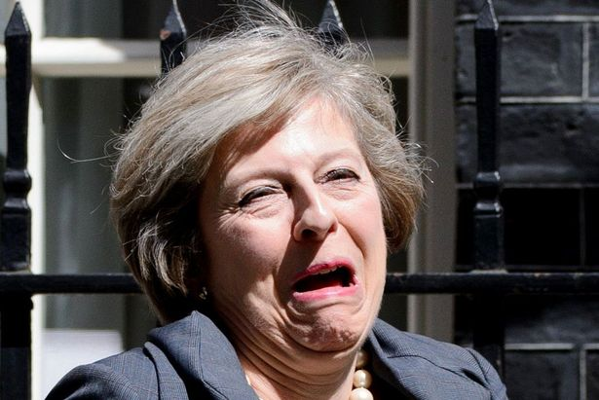
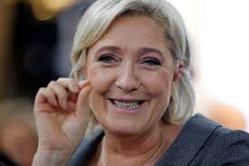
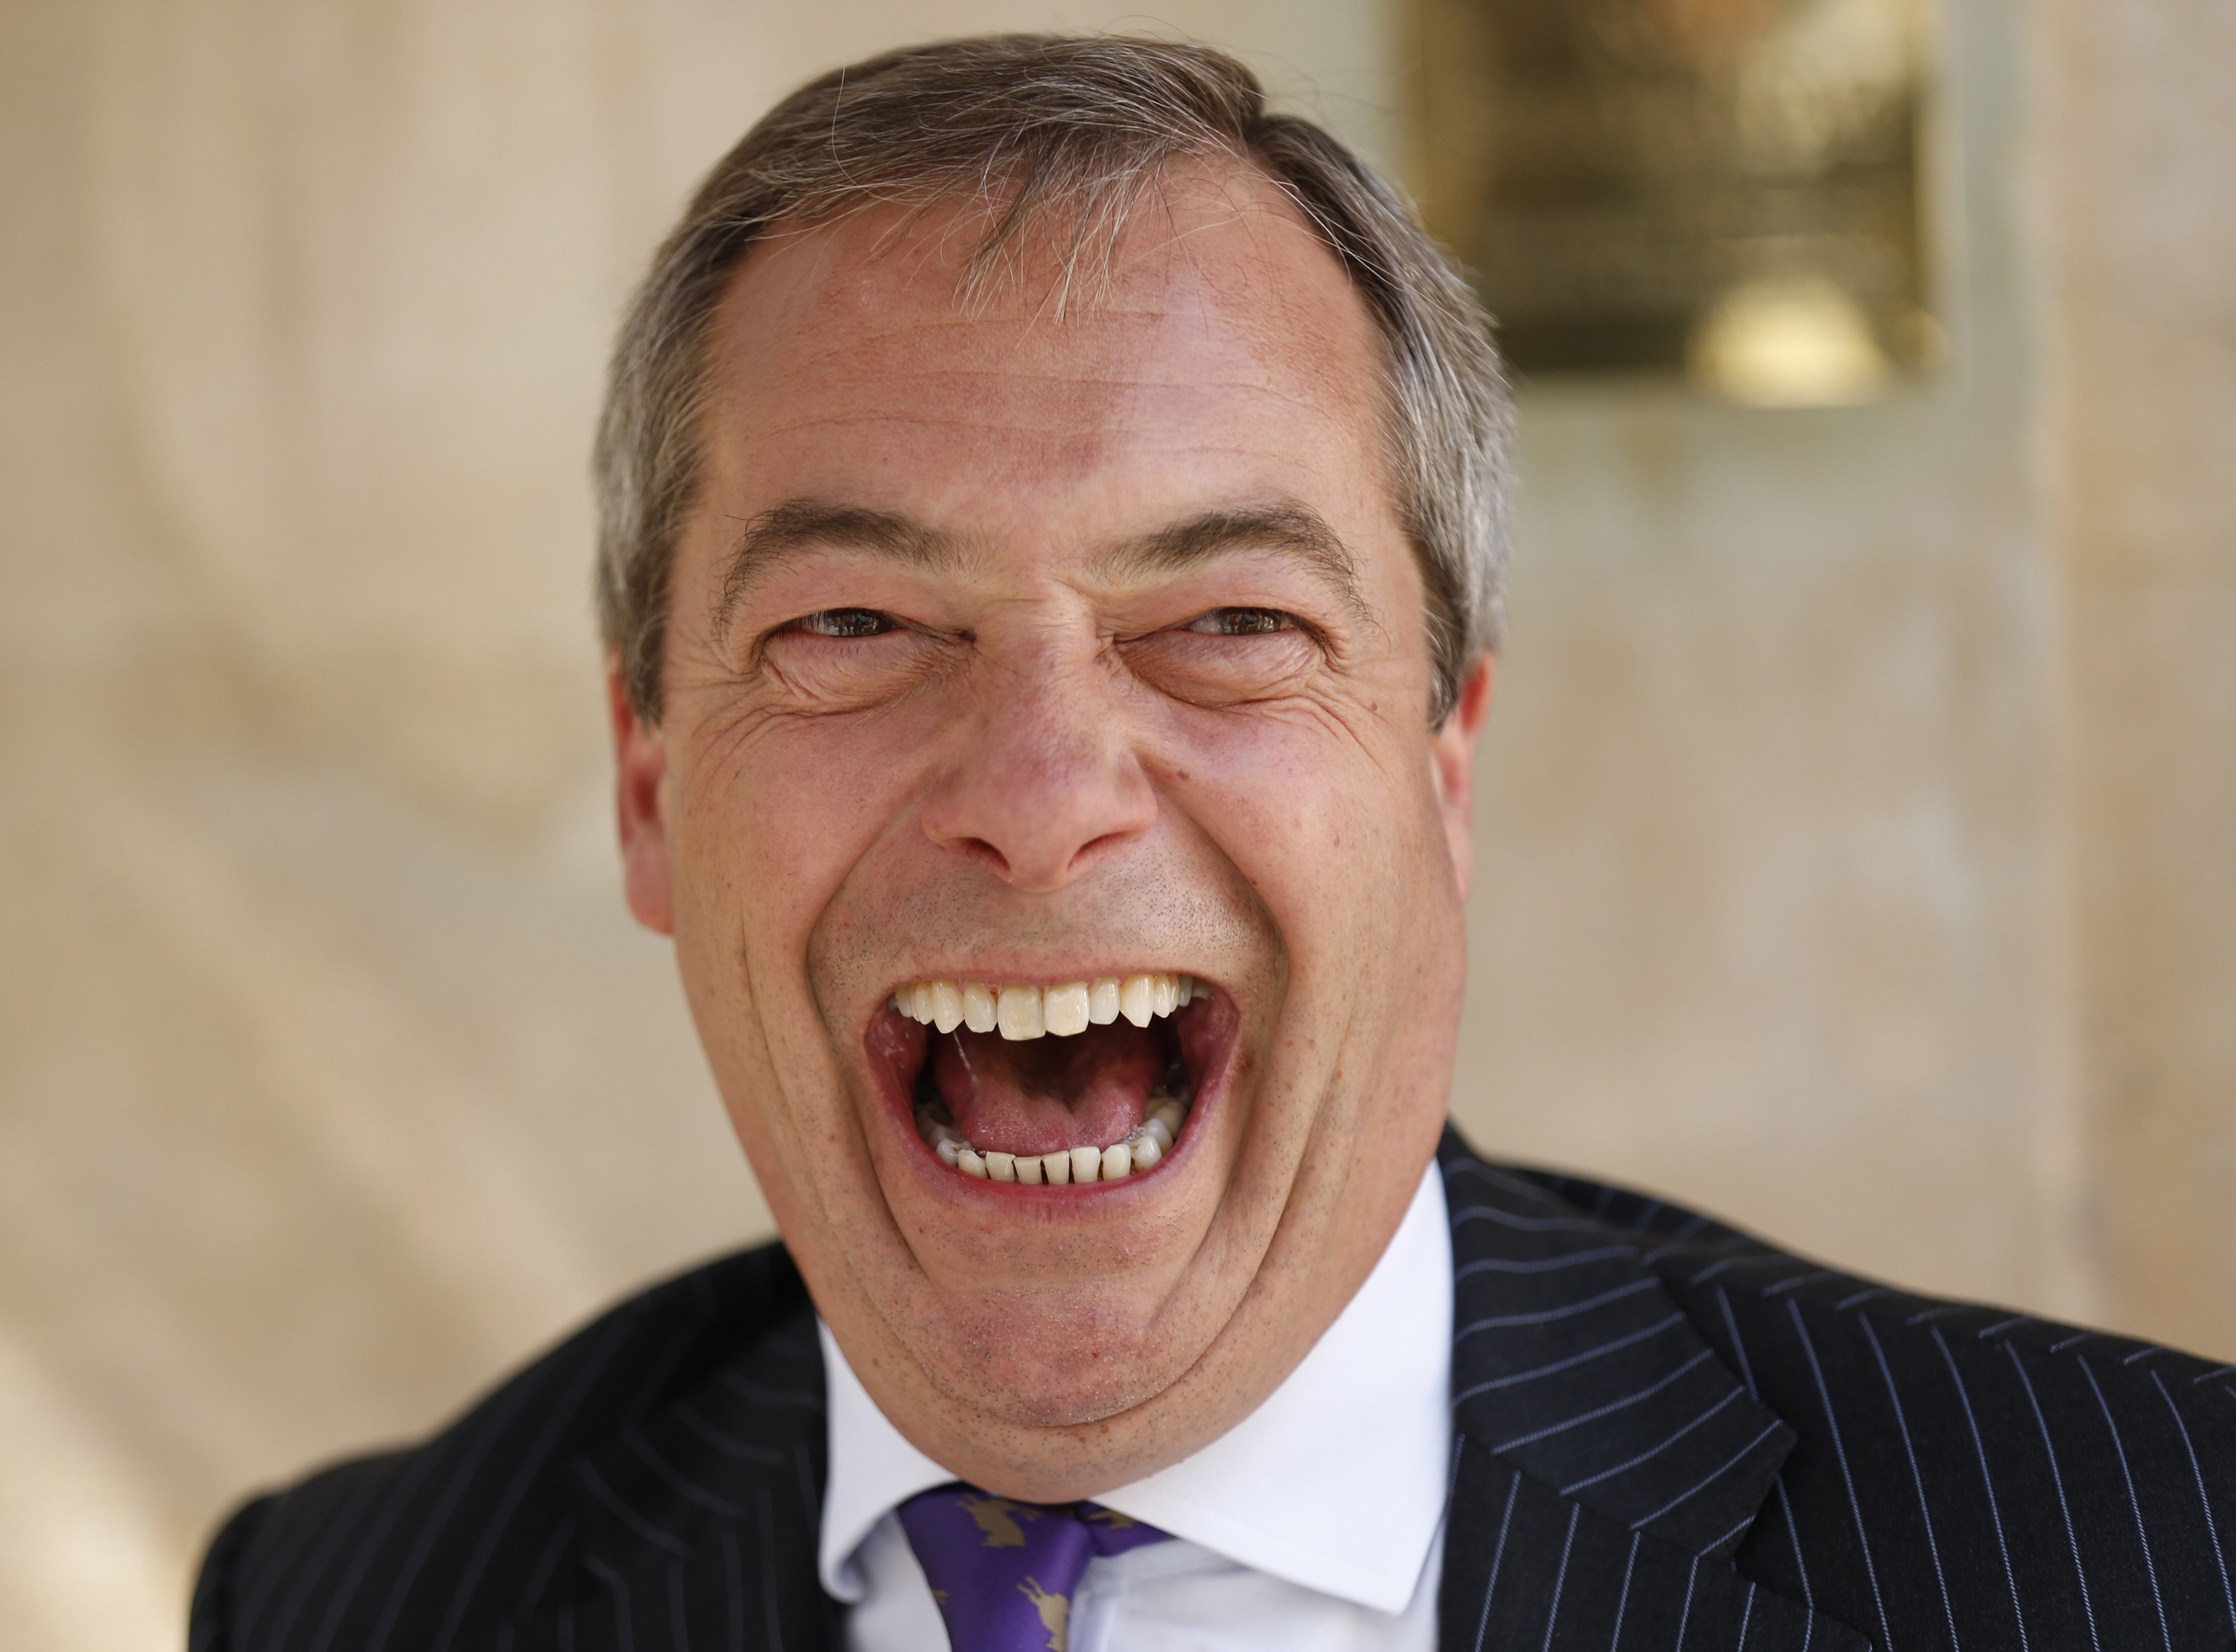
Be careful who you vote for
What measures most benefit Public Health and reduce health inequalities?
- Proportionate universalism
- Tax
- Price measures
- Regulation
- Legislation
Avoid lifestyle drift
See Marmot Review 2010
http://www.instituteofhealthequity.org/projects/fair-society-healthy-lives-the-marmot-review
(images in this slide are not related to Marmot Review in any way)
Notes:
Evidence, politics, influence and loss of supranational influence and collaboration

Slide 24
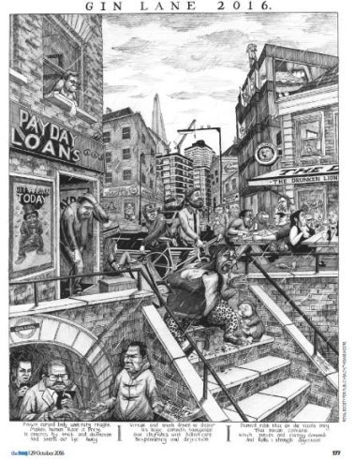

Slide 25
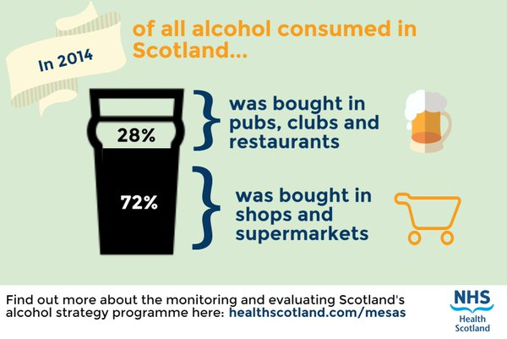
Notes:
What about alcohol?

Slide 26
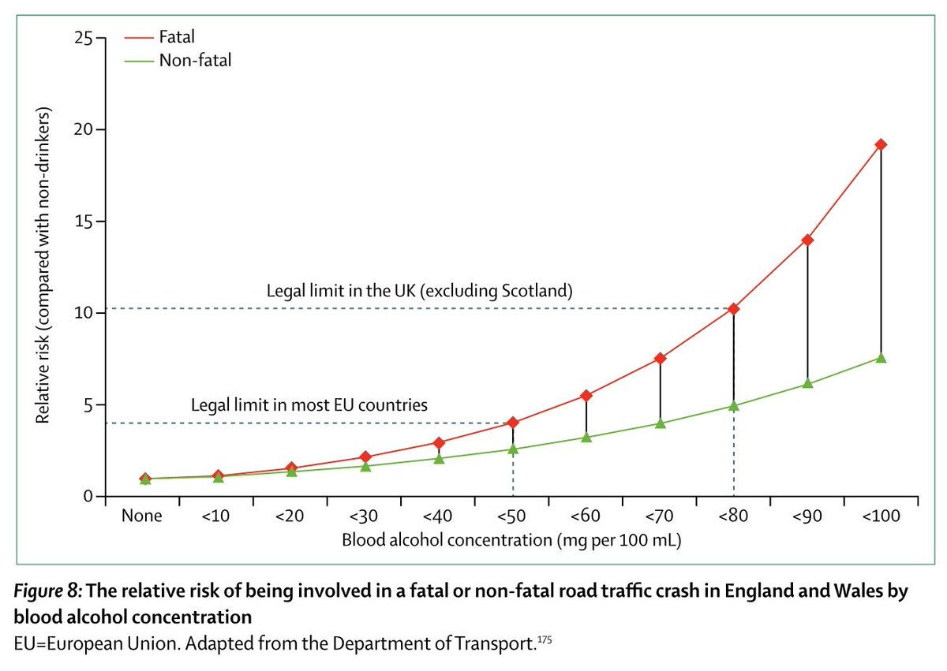
http://www.thelancet.com/journals/lancet/article/PIIS0140-6736(16)32420-5/fulltext
Notes:
Is public ready for further population level measures?

Slide 27
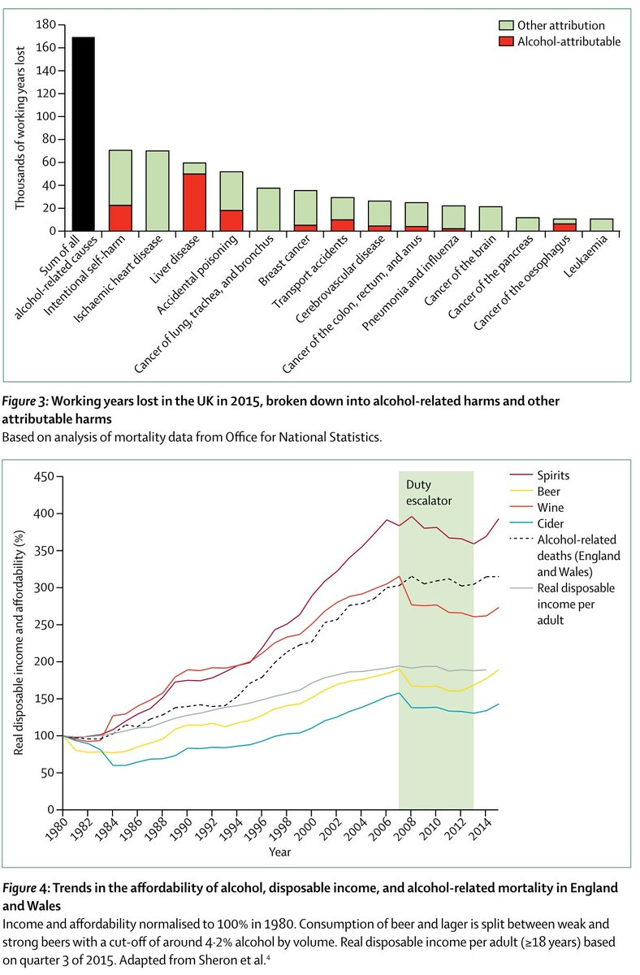
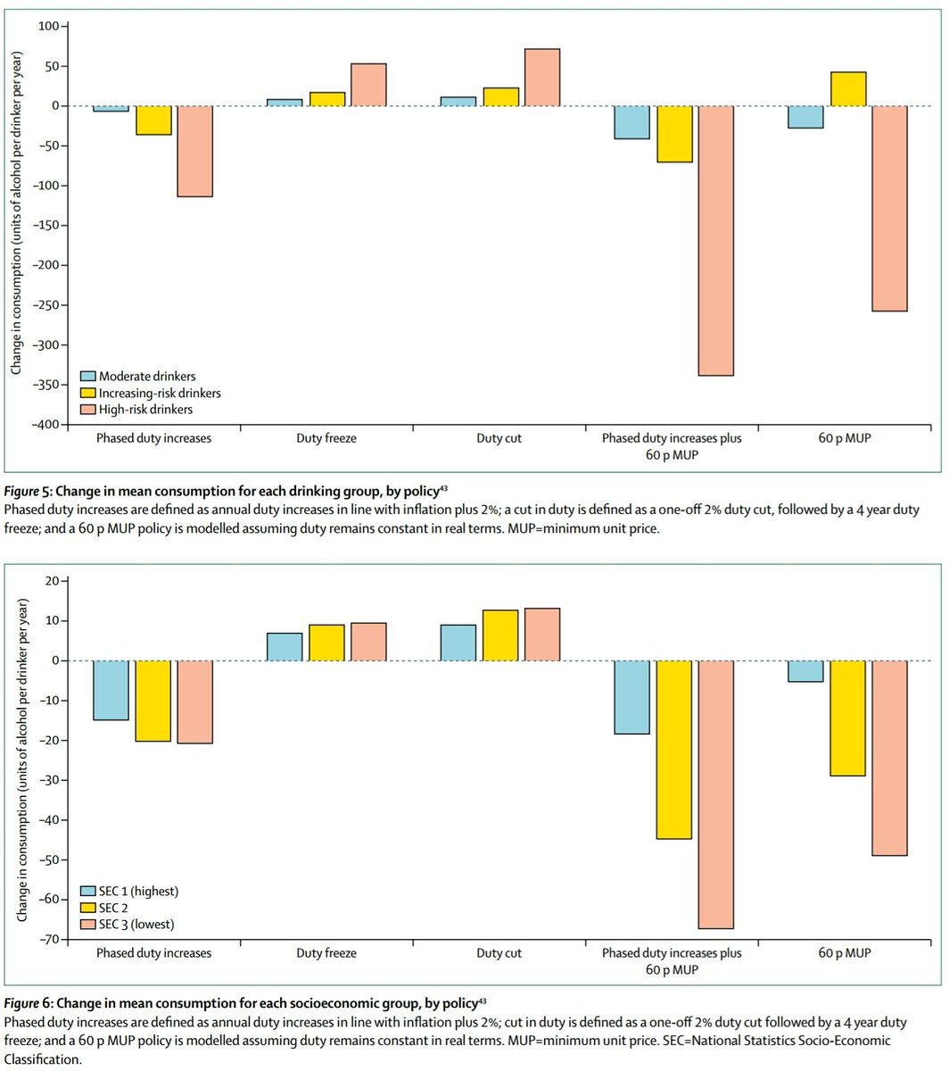
Notes:
Describe epidemiology, asking re TPP (time, place, person)

Slide 28
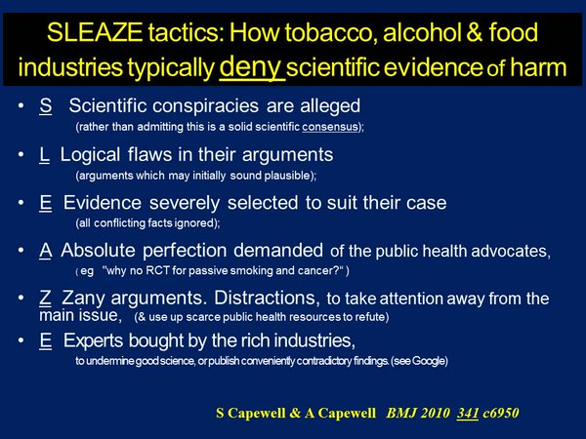
http://www.bmj.com/rapid-response/2011/11/03/how-denialism-undermines-public-health-beware-sleaze
@SimonCapewell99 on Twitter
Notes:
Simon and Ann Capewell’s SLEAZE factors

Slide 29
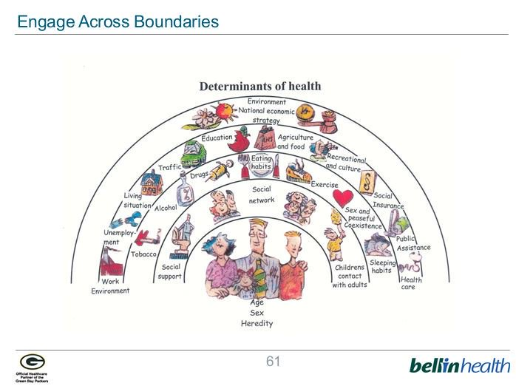
Dahlgren and Whitehead’s model of social determinants of health (updated)
https://core.ac.uk/download/pdf/6472456.pdf

Slide 30
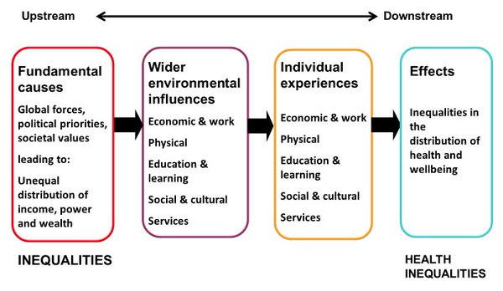
Health inequalities: theory of causation
http://www.gov.scot/Publications/2014/03/2561/5
Notes:
How do inequalities and health inequalities fit together?

Slide 31
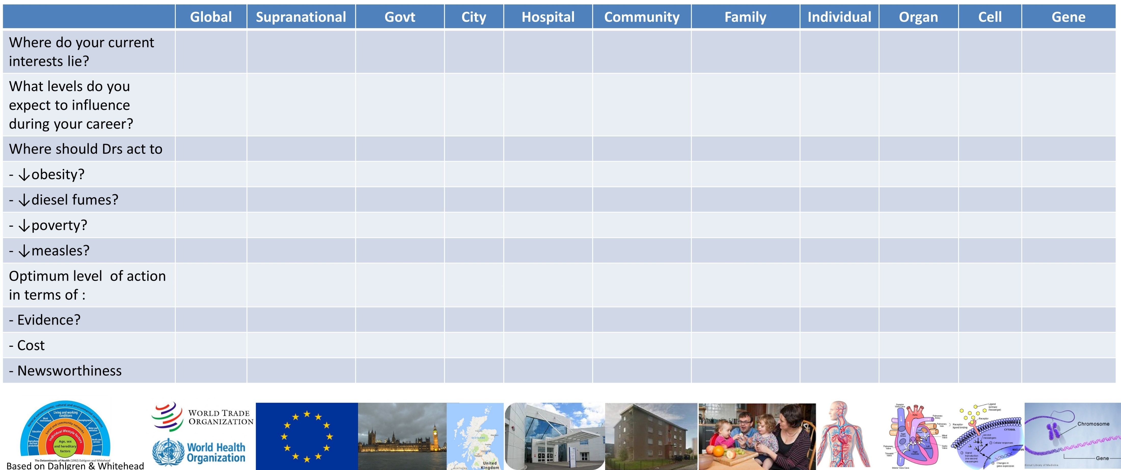
Notes:
An exercise if time, and a framework to consider new topics further

Slide 32
What is the role of Public Health doctors in tackling contemporary health problems?
Dr Graham Mackenzie
Consultant in Public Health Medicine, NHS Lothian
@gmacscotland on Twitter www.scotpublichealth.com

