Slide 1
Webex:
Health Inequalities
1 June 2016

Slide 2
What do we mean by health inequalities?
Health inequalities are:
Unfair differences in health within the population across social classes and between different populations
These unfair differences:
Are not random, or by chance, but largely socially determined
Are not inevitable.

Slide 3
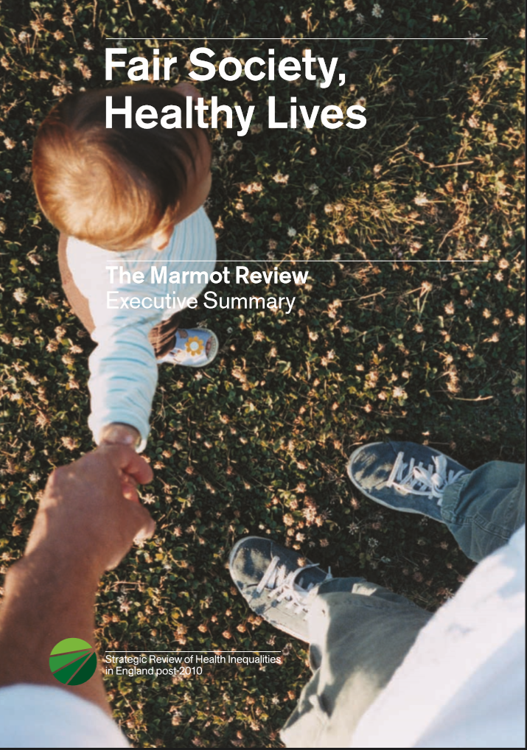
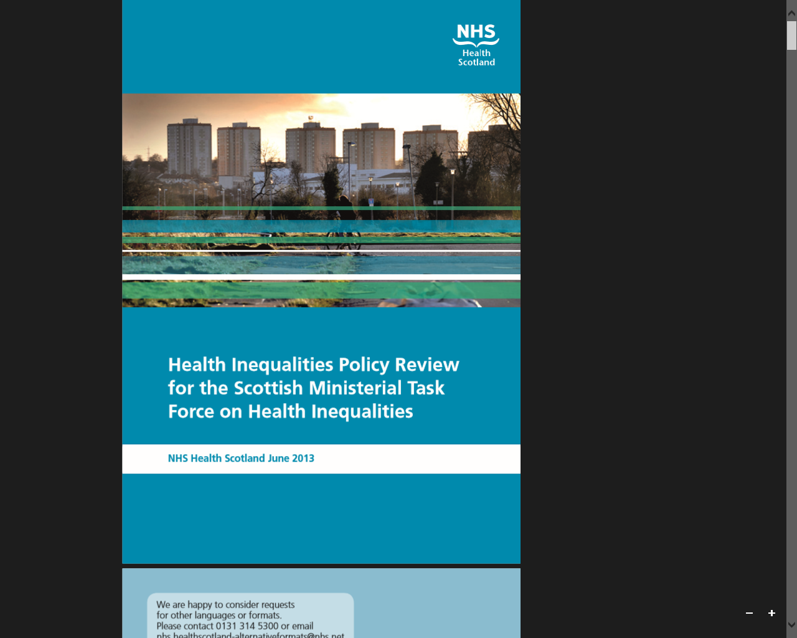
Notes:
But there is a lot out there:
NICE
ACE
Marmot
WHO
Inequalities Policy Review, NHS Health Scotland
Macintyre
Kings Fund, PHE and IHE
Expert opinion….

Slide 4

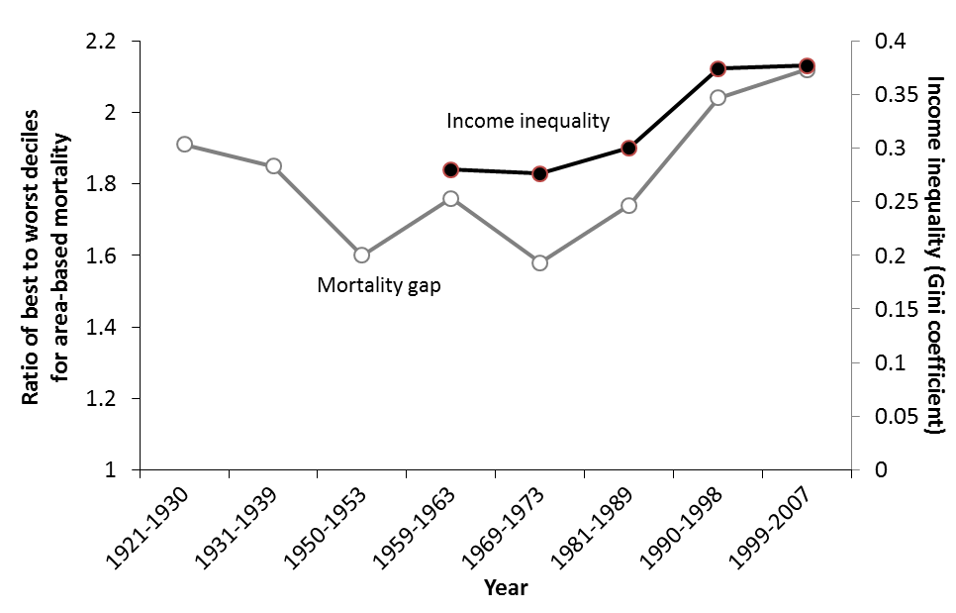
Mortality gap between local authorities and income inequalities in GB 1921-2007
(Source: Thomas & Dorling 2010, IFS 2012)
Notes:
But as I said at the beginning, health inequalities are not inevitable. There have been times and places when they are less than they are now.
This chart shows how a measure of health inequality has changed in GB over the period 1921 – 2007 (the grey line). It shows it decreasing, particularly in the post war period during the time of institution building (state pensions, health services, local government), social solidarity and decreasing income inequalities.
However, the trends in both the UK and USA reversed from the 1970s to the present day, corresponding with a period of rapid economic growth, privatisation, increasing individualism and increasing income inequalities in both countries

Slide 5
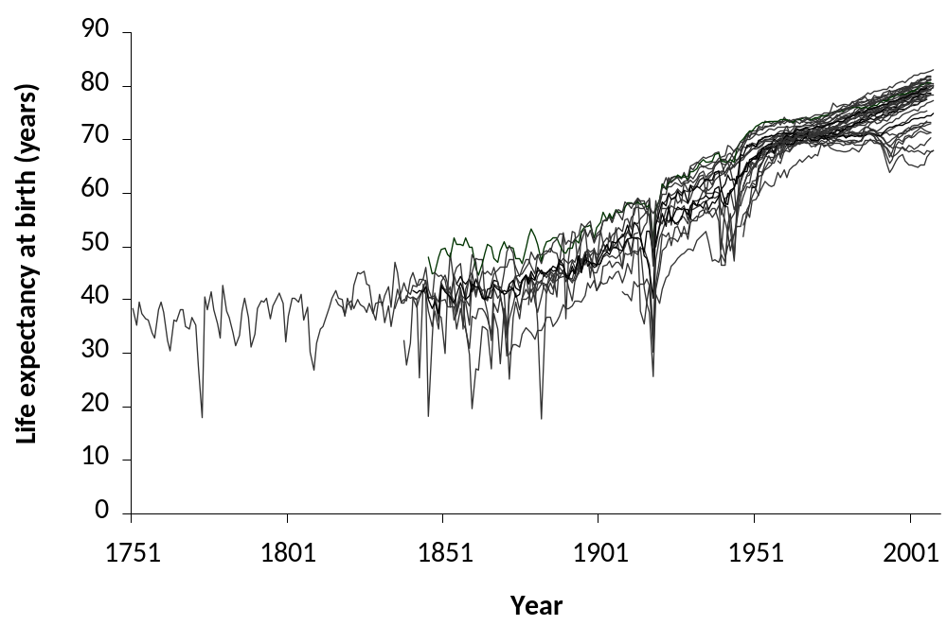
Historical international trends in life expectancy
Data extracted from the Human Mortality Database for all available nations: Australia, Austria, Belgium, Belarus, Bulgaria, Canada, Chile, Czech Republic, Denmark, East Germany, England & Wales, Estonia, Finland, France, Germany, Hungary, Ireland, Iceland, Israel, Italy, Japan, Latvia, Lithuania, Luxembourg, Netherlands, New Zealand, Northern Ireland, Norway, Poland, Portugal, Russia, Scotland, Slovakia, Slovenia, Spain, Sweden, Switzerland, Taiwan, West Germany, Ukraine & USA.
Notes:
250 year view, Europe and wealthy and developed countries around the world
Average life expectancy – mid-30s, held down by death around birth, epidemics of CD.
Eg Mozart, Beethoven
20th century, severe dips in the 2 World Wars but dramatic progress from average 45 to 75 – 30 years progress in 100 years, still improving but several threats and substantial inequalities

Slide 6
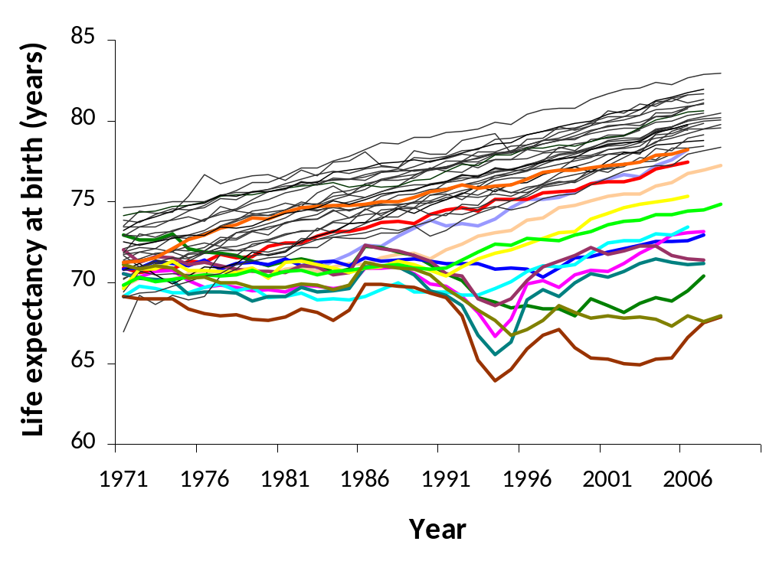
Higher overall mortality than comparable nations
USA
Slovenia
Scotland
Czech R.
Poland
Slovakia
Hungary
Estonia
Bulgaria
Lithuania
Latvia
Belarus
Ukraine
Russia
Data extracted from the Human Mortality Database for: Australia, Austria, Belgium, Belarus, Bulgaria, Canada, Chile, Czech Republic, Denmark, East Germany, England & Wales, Estonia, Finland, France, Germany, Hungary, Ireland, Iceland, Israel, Italy, Japan, Latvia, Lithuania, Luxembourg, Netherlands, New Zealand, Northern Ireland, Norway, Poland, Portugal, Russia, Scotland, Slovakia, Slovenia, Spain, Sweden, Switzerland, Taiwan, West Germany, Ukraine & USA.
Notes:
Look at the right hand end of that 250 year graph – the lst 30 years
Many countries making steady progress
Old Soviet block has really struggled since its collapse & the fall of the Berlin wall
Scotland in Red, US in orange – middle of the pack in the premier league but dropping to the bottom of the best

Slide 7
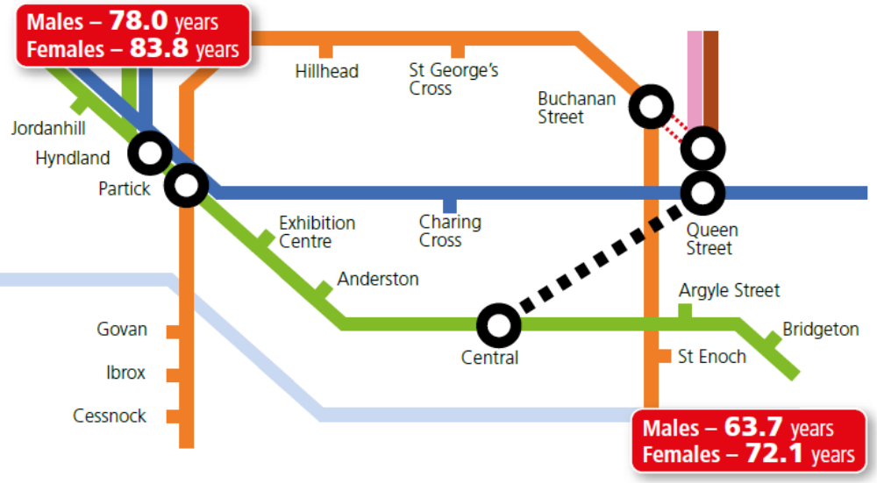
These data have been updated using the ScotPHO profiles published in June 2015 comparing the life expectancies in Broomhill (close to Jordanhill station) and Parkhead & Barrowfield (close to Bridgeton station) intermediate zones.

Slide 8
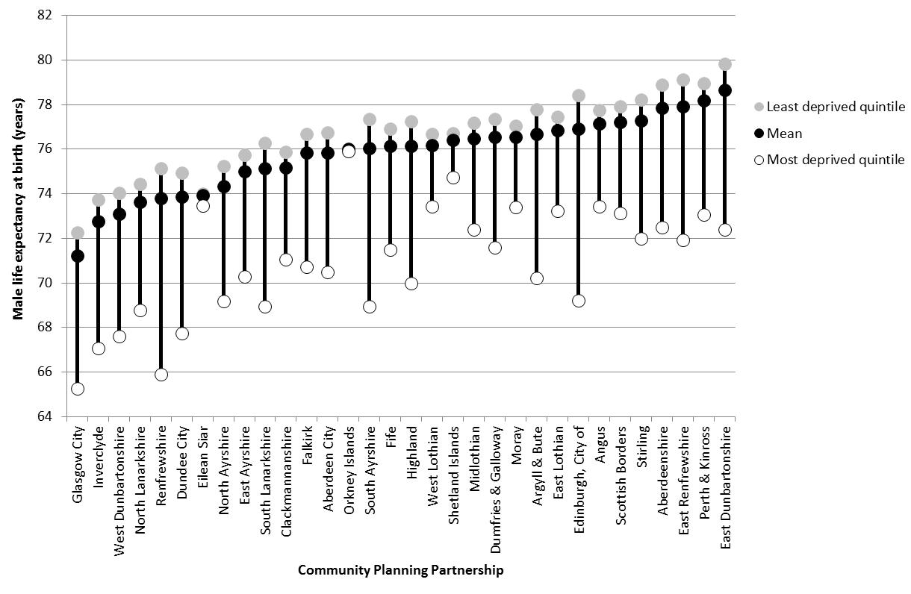
8
Notes:
??

Slide 9
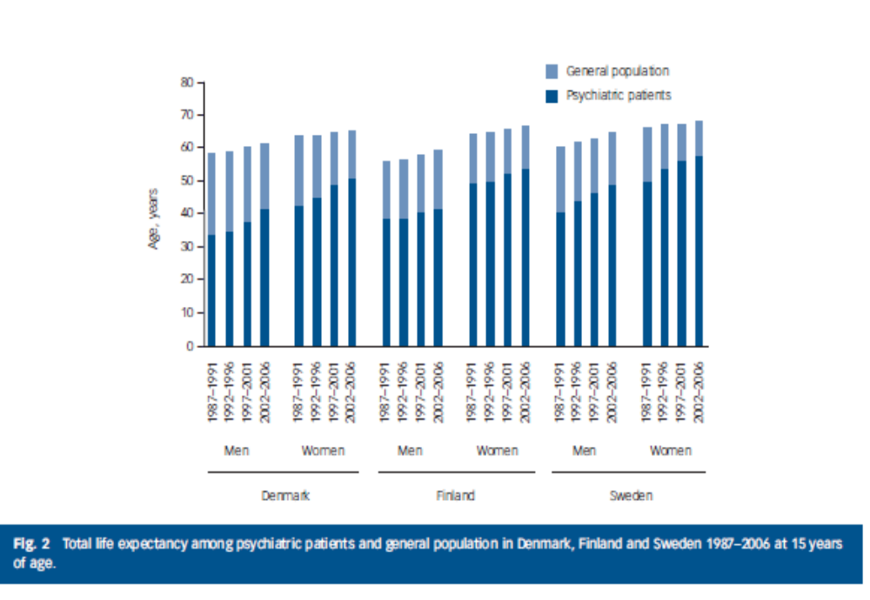
Mental health:
Shorter life expectancy, 3 Scandinavian Countries

Slide 10
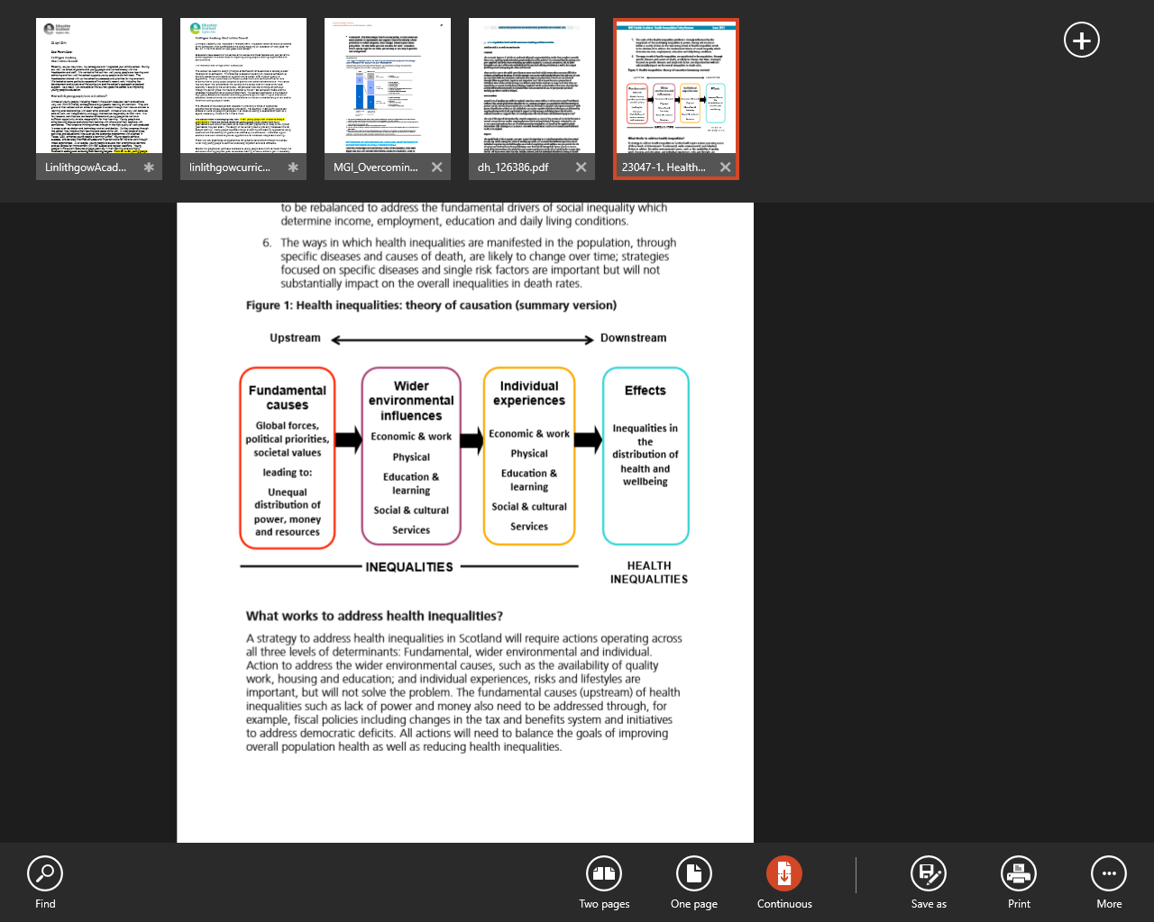
Notes:
Given the role of the social determinants of health in driving need and service use, prevention is about more than just health care or health promotion, it also includes things like housing, greenspace, good work, education, tax policies etc,.
Key message? Tough choices need to be made about how much we invest in prevention and what forms of prevention we invest in.
To focus such efforts, the HS policy review includes this diagram of the causes of HIs.
It highlights the links between wider social, economic and environmental inequalities and health inequalities.
It distinguishes between what it calls fundamental causes rooted in the social and economic system, and more direct causes at an individual level.
It stresses the links between the two – individual risk factors need to be understood in terms of the influence of the wider social, economic and physical environment.
And perhaps most importantly it stresses the need for what it calls upstream prevention to tackle the fundamental causes of health inequalities.

Slide 11
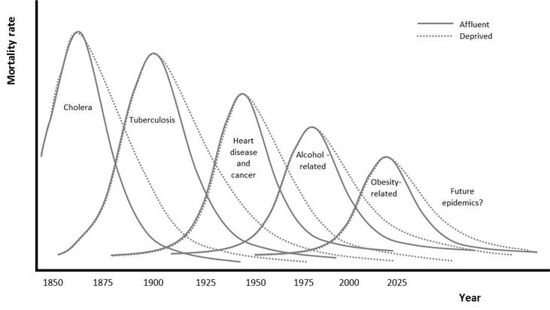
Schematic representation of the changing causes of health inequalities over time
Notes:
So, what can be done?
Action needs to be taken to address the underlying causes of health inequalities, rather than focusing solely on specific diseases or risk factors. This schematic diagram illustrates this:
So in the 19th century, in the era of infectious disease, when disease first emerged they affected rich and poor alike, but as it was understood that these diseases were transmitted by unclean water and through over crowding, and the rich made changes, inequalities started to appear. As clean water and overcrowding were addressed by social reform , heart disease and cancer became a more import cause of death and then inequality. As these improved they were replaced by alcohol-related and now obesity related disease.
So there are inequalities in disease specific mortality rate, for example death from ischemic heart disease, and these can and do improve as treatment and prevention improves, but because the underlying causes are not addressed the manifestation simply changes – strategies focussed on specific diseases and single risk factors are important but will not substantially impact on the overall inequalities in death rates.
This is because health inequalities are underpinned by the same fundamental cause of health inequalities we will not solve the problem the manifestation simply changes.

Slide 12
What causes health inequalities?
Inequalities in income, resources and power
Health behaviours (e.g. smoking and alcohol) or individual skills (e.g. parenting or employability) offer only very partial and incomplete explanations
Sources:
Commission on Social Determinants of Health. 2008. Closing the gap in a generation: Health equity through action on the social determinants of health. Final Report of the Commission on Social Determinants of Health. Geneva, World Health Organization.
Equally Well Policy Review. Edinburgh, NHS Health Scotland, 2013.
McCartney G, Collins C, MacKenzie M. What (or Who) causes health inequalities: theories, evidence and implications? Health Policy 2013; 113: 221– 227.

Slide 13
Thanks to Gerry McCartney, Wendy Hearty & Colwyn Jones for slides and material.
Graham Mackenzie for practical and pastoral support as a Webex rookie

Slide 14
What do we do to tackle Inequalities?

Slide 15
What is most and least effective in reducing health inequalities?
Most likely to be effective
Structural changes to the environment; legislation, regulatory and fiscal policies; income support, reduced price barriers; accessibility of public services, prioritising disadvantaged groups and individuals; intensive support for disadvantaged population groups; starting young.
Least likely to be effective
Interventions reliant on people opting in; information based campaigns; written materials; messages designed for the whole population; interventions that involve significant price or other barrier
Notes:
This feels slightly ‘preachy’ and may be better less detailed in a slide, but could well be points that AF would be well placed to expand upon…
15

Slide 16
Addressing health inequalities
Fundamental causes | Policies that redistribute power, money and resources Social equity and social justice prioritised | Living wage Creating employment
Wider environmental influences | Use of legislation, regulation, standards and fiscal policy Structural changes to the physical environment Reducing price barriers Ensuring good work is available for all Equitable provision of high quality and accessible education and public services | Housing quality standard extended to private rented Place standard Regulate retail outlets
Individual experiences | Equitable experience of socio-economic and wider environmental influences Equitable experience of public services Targeting high risk individuals Intensive tailored individual support Focus on young children and the early years | Training – culturally/inequalities sensitive practice Linked public services for vulnerable/high risk individuals
Notes:
Think this one’s quite useful

Slide 17
What have we been doing to address health inequalities in Scotland?
Good aspirations but downstream drift
Assume health improvement = reduction of health inequalities
Often target using area based deprivation as proxy for need
Led by health – limited cross government spread
Largely helping individuals to resist or prevent the impacts of inequality
May stop inequalities widening uncontrollably
But in order to undo or eliminate, health inequalities, action also needs to be taken to address the fundamental causes.
Notes:
What have we been doing to address health inequalities in Scotland? (brief overview with key points taken from below)
Equally Well is the Scottish Government strategy for addressing health inequalities
Aimed to address the fundamental and ‘upstream’ factors that cause health inequalities
Delivery tended to focus on addressing ‘downstream’ consequences
Limited spread of learning from the Equally Well test sites
Much of the current public health action on health inequalities focusing on mitigating the impacts of social or helps individuals to resist these impacts
This may help to stop health inequalities widening uncontrollably
But in order to undo or eliminate, health inequalities, action also needs to be taken to address the fundamental causes
The Task Force report Equally Well, was published in 2008 set out the joint Scottish Government/COSLA strategy for addressing Health Inequalities. The strategy was reviewed in 2010. The work we do in Health Scotland, such as building the evidence, will support better policy making
However, given that:
Inequalities are caused by the unequal distribution of power, money and resources in a society (the ‘fundamental’ causes)
This unequal distribution impacts on access to good quality work, education and learning, social and cultural services etc.(the wider environmental influences)
These inequalities shape individual experiences and health throughout life
There needs to be a shift in action…

Slide 18
The Political framework for 2016-21 in Scotland
2007–13 Economy dominant
2013-16 Social justice dominant
2016- Economy and Attainment: austerity, inequalities ?
Opportunities to tackle inequalities:
Framed in Fair Society: Healthy Lives
Equitable economic progress
Determinants of equitable children’s attainment
Levelling up and not trickling down

Slide 19
Recent research – modelling the effects of Interventions
Changes to taxation (1p on the Scottish rate of income tax, a 10% rise council tax)
Changes to benefits (a 10% increase in the value of job seekers’ allowance and income support, a 10% increase in basic and 30-hour working tax credits)
Introduction of a ‘living wage’;
An increase in the level of tobacco tax;
Greater provision of smoking cessation services;
Greater provision of alcohol brief interventions (ABIs);
Greater provision of a ‘Counterweight’ weight management service;
Changes in levels of employment; and
Changes in the extent of active commuting (walking and cycling to work).
Notes:
Likewise…but this is maybe getting too detailed for an intro to AFHS, which is effectively what this presentation is

Slide 20
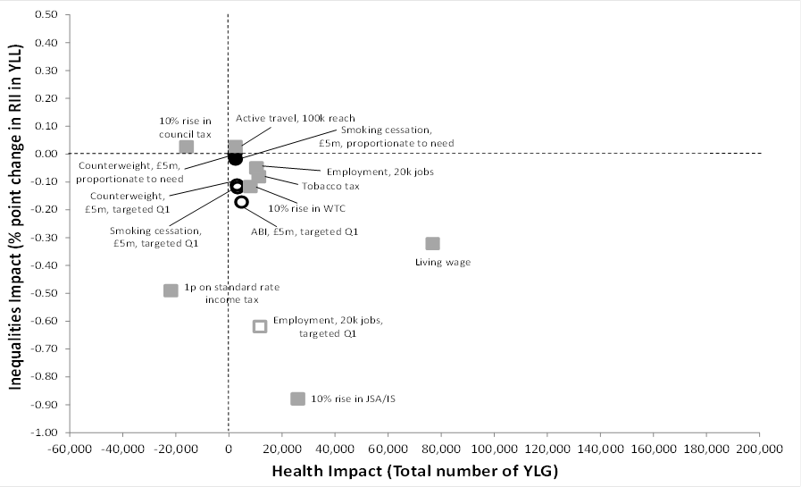
Modelled changes on mortality and inequalities after 10 years (based on £5m investment)
Notes:
As above

Slide 21
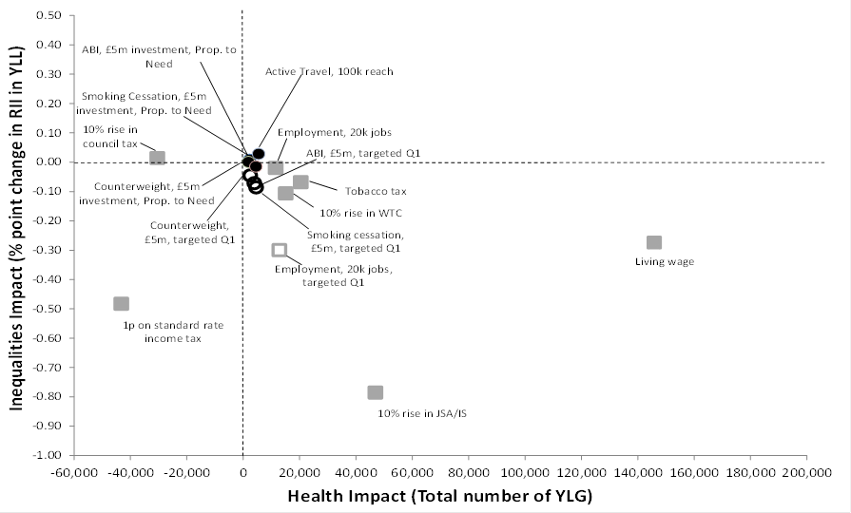
Modelled changes on mortality and inequalities after 20 years (based on £5m investment)
Notes:
As above

Slide 22
Absolute Inequalities:
Relative Inequalities

Slide 23
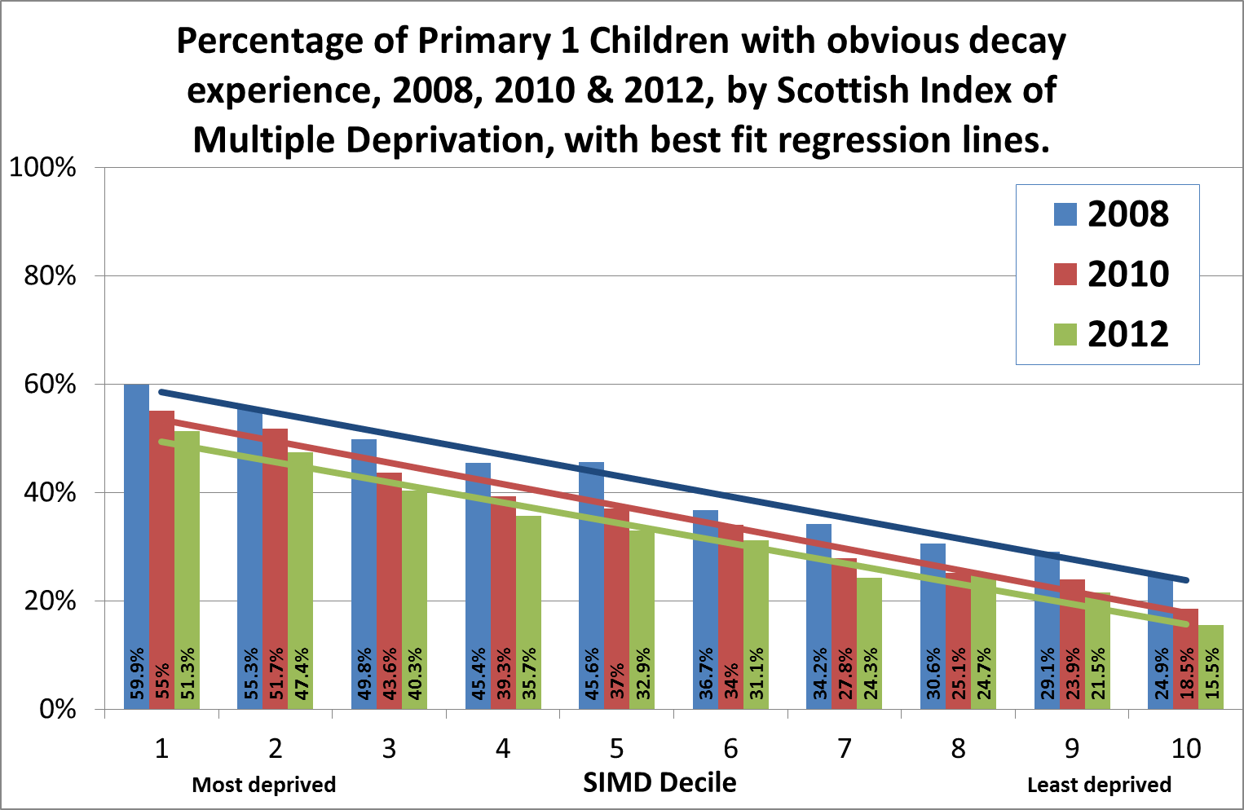

Slide 24
Schematic representation of the changing causes of health inequalities over time
Notes:
So, what can be done?
Action needs to be taken to address the underlying causes of health inequalities, rather than focusing solely on specific diseases or risk factors. This schematic diagram illustrates this:
So in the 19th century, in the era of infectious disease, when disease first emerged they affected rich and poor alike, but as it was understood that these diseases were transmitted by unclean water and through over crowding, and the rich made changes, inequalities started to appear. As clean water and overcrowding were addressed by social reform , heart disease and cancer became a more import cause of death and then inequality. As these improved they were replaced by alcohol-related and now obesity related disease.
So there are inequalities in disease specific mortality rate, for example death from ischemic heart disease, and these can and do improve as treatment and prevention improves, but because the underlying causes are not addressed the manifestation simply changes – strategies focussed on specific diseases and single risk factors are important but will not substantially impact on the overall inequalities in death rates.
This is because health inequalities are underpinned by the same fundamental cause of health inequalities we will not solve the problem the manifestation simply changes.

Slide 25
Webex:
Health Inequalities
1 June 2016

