Slide 1
The role of social media in creating a #FairerHealthierScotland
Laura Blair
Senior Communications and
Engagement Officer
June 2016

Slide 2




Channels

Slide 3
Twitter
Provides information about health inequalities and the action needed to reduce them.
Promotes our public and professional health improvement resources.
Followers include politicians, civil servants, local government officers, the media and private, public and third sector organisations.
We have over 11.3K followers (a large following for a health board in Scotland).
We have earned on average 127 additional new followers each month since a social media strategy has been in place (2015-16).
We achieve a consistent engagement rate of 1.0%.
We are ‘mentioned’ daily.

Slide 4
Promote, Position, Protect
Fundamental communications channel
Webinar
Live tweet from events
Live tweet from Board meetings
Support official accounts (Chair, CEO, Director)
Forward plan content and develop ‘good tweet’

Slide 5
Writing good tweet
What is the news?
Think about style (Announcement, teaser, question)
Think about reach (include a relevant hashtag and a partner’s handle to encourage a RT)
What will enhance your tweet?
  Web link
  Image
  Audio/video

Slide 6
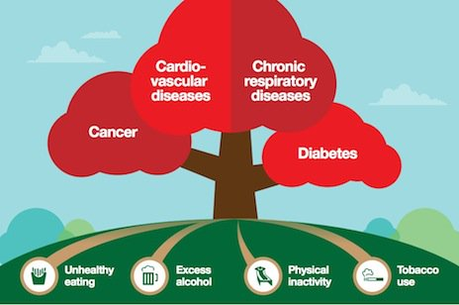
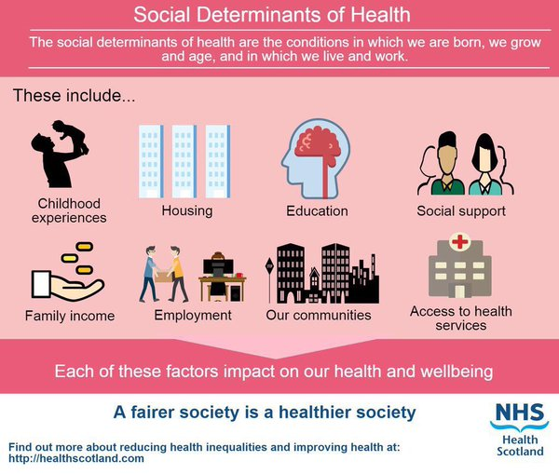

Slide 7
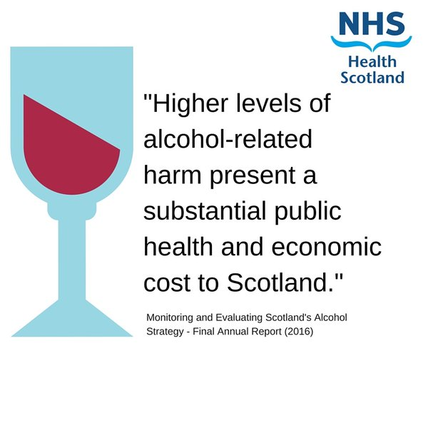

Slide 8
The role of social media in creating a #FairerHealthierScotland
@NHS_HS #HealthInequalities
@lauraABlair #socialmedia

